Slide 1


Slide 2


Slide 3


Slide 4


Slide 5
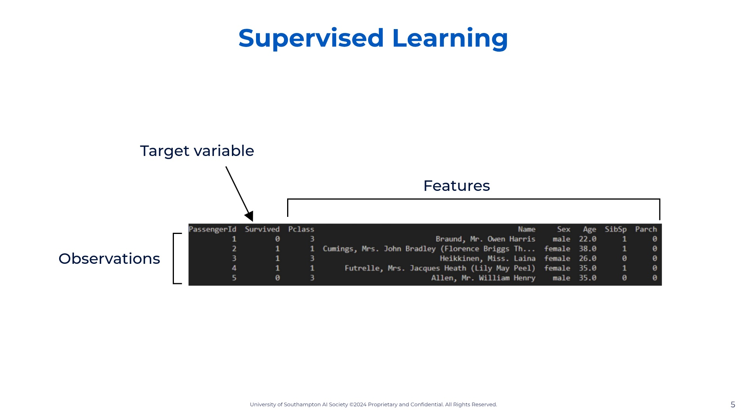

Slide 6
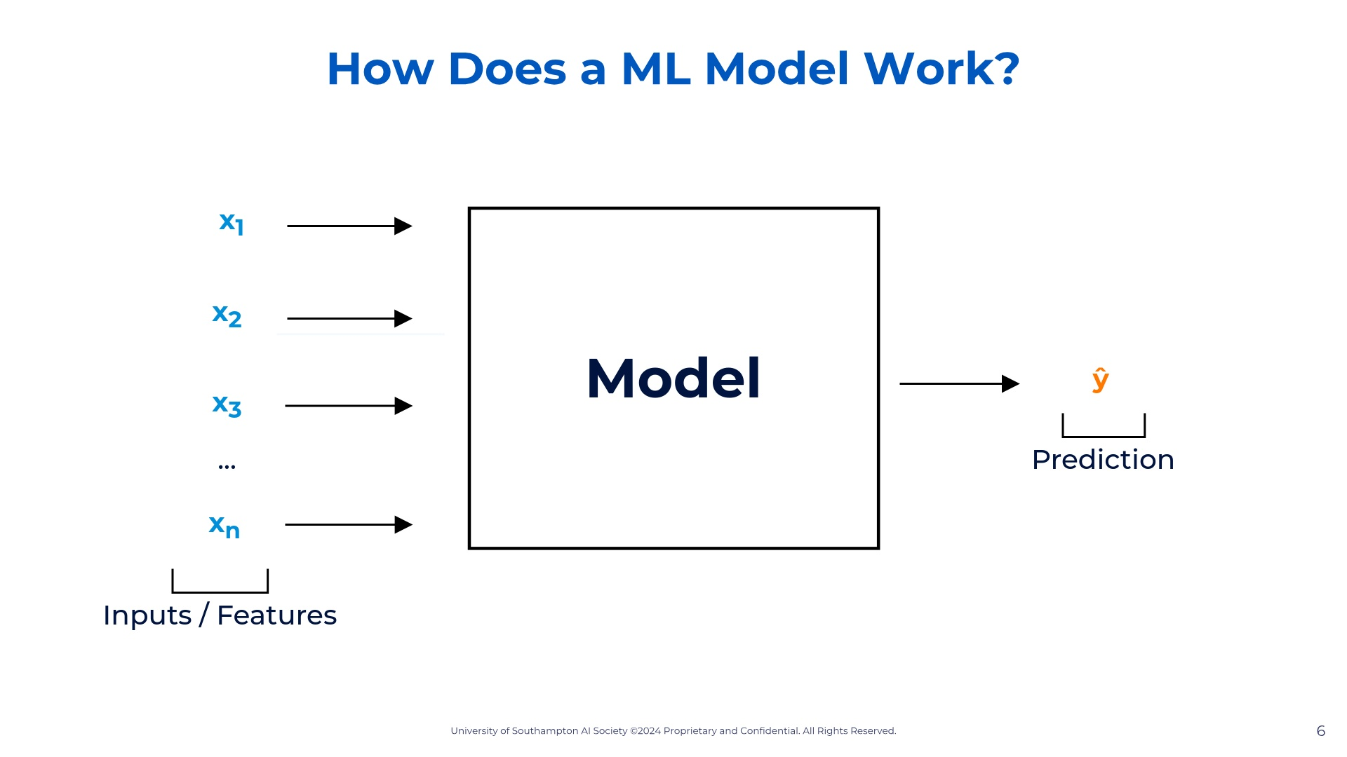

Slide 7
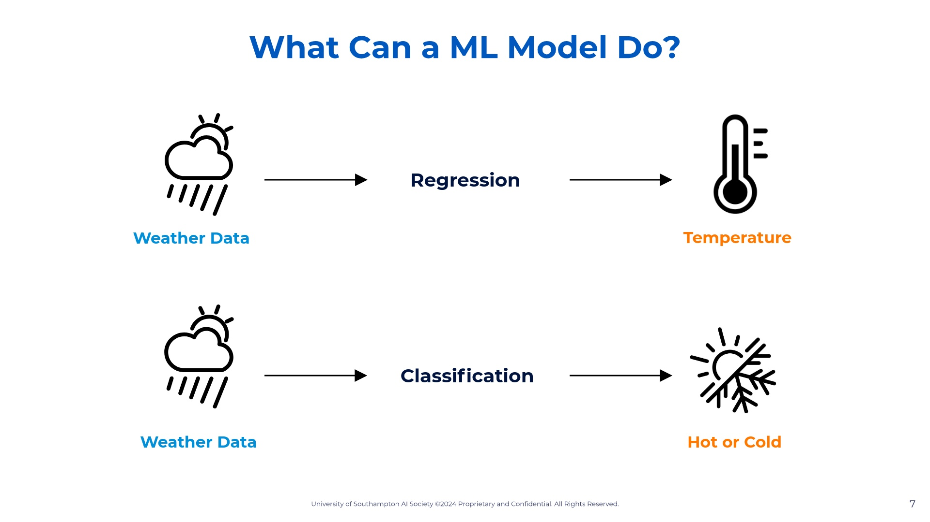

Slide 8


Slide 9
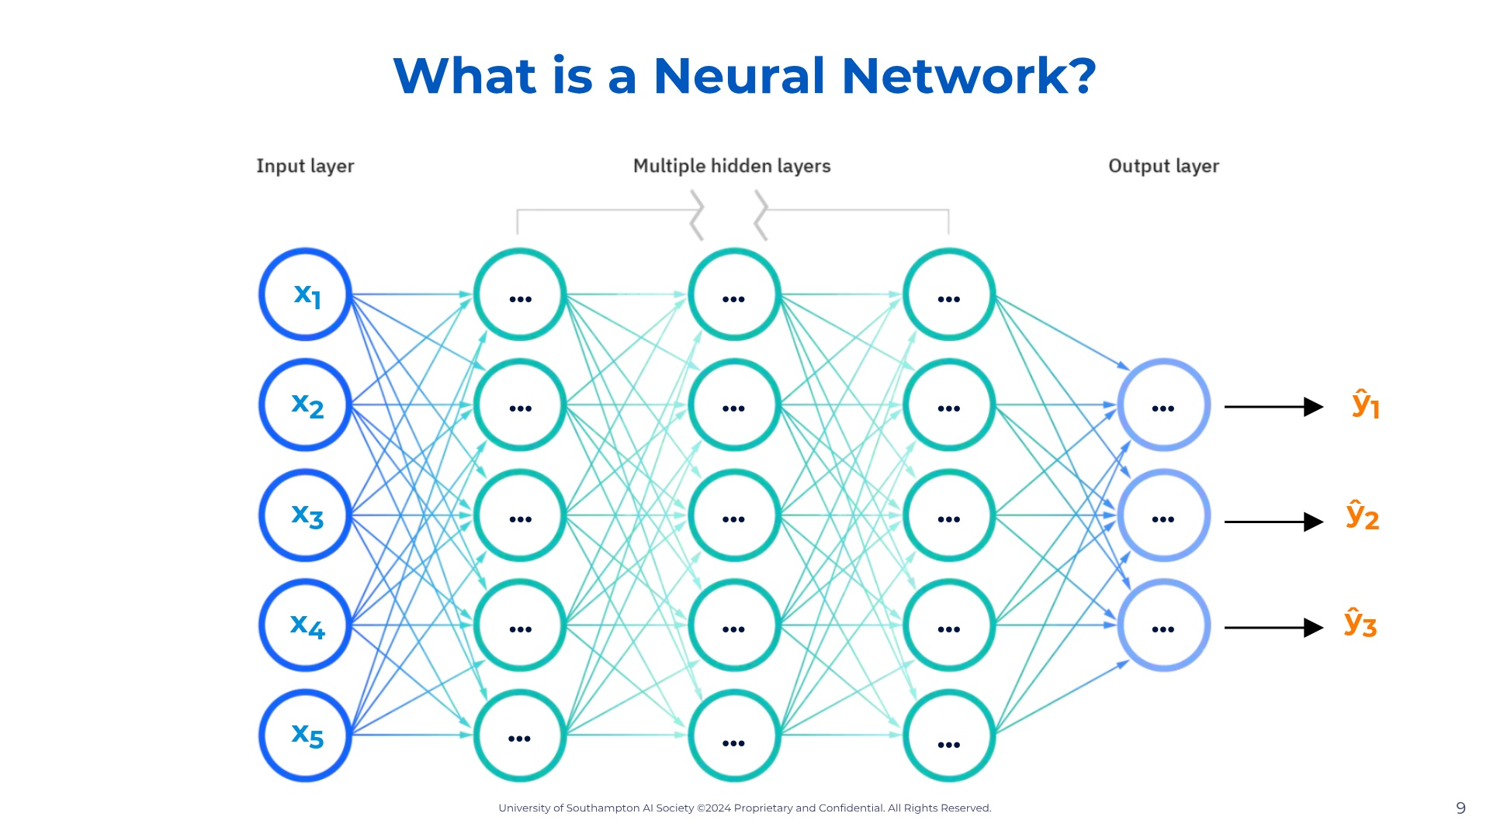

Slide 10
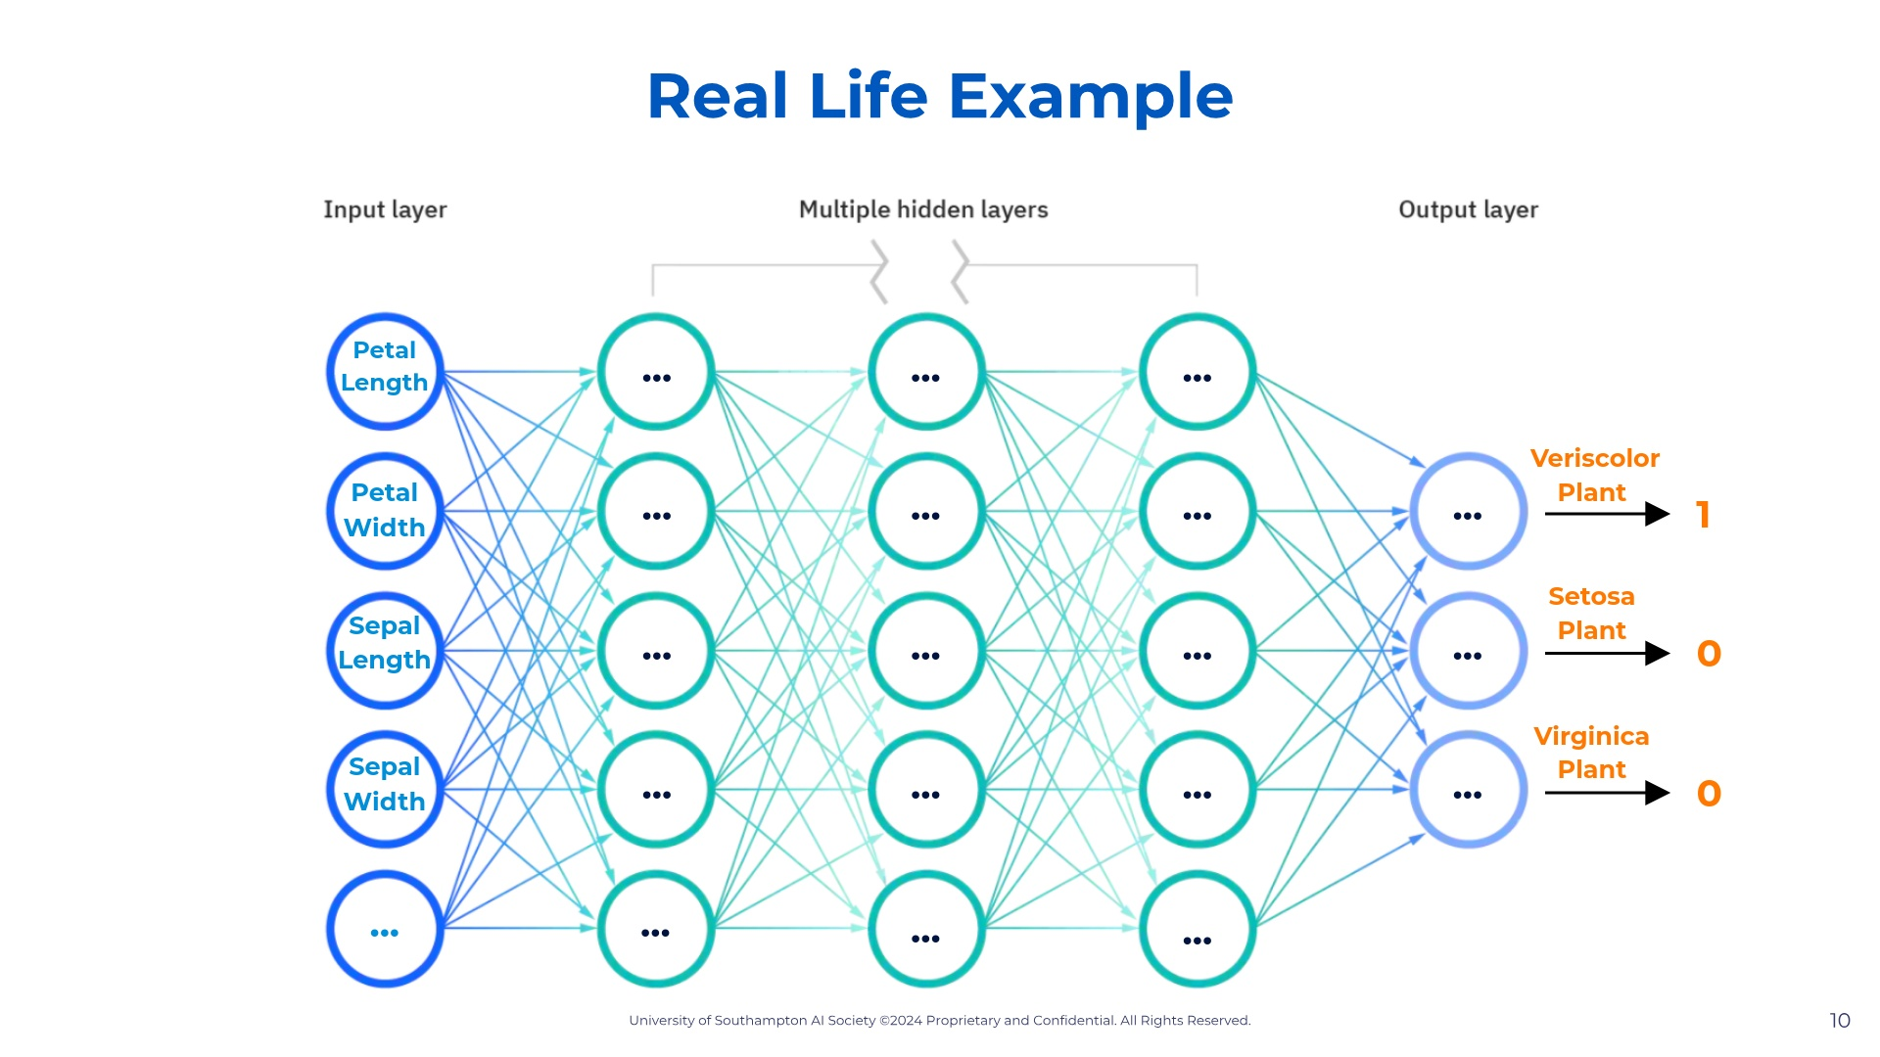

Slide 11
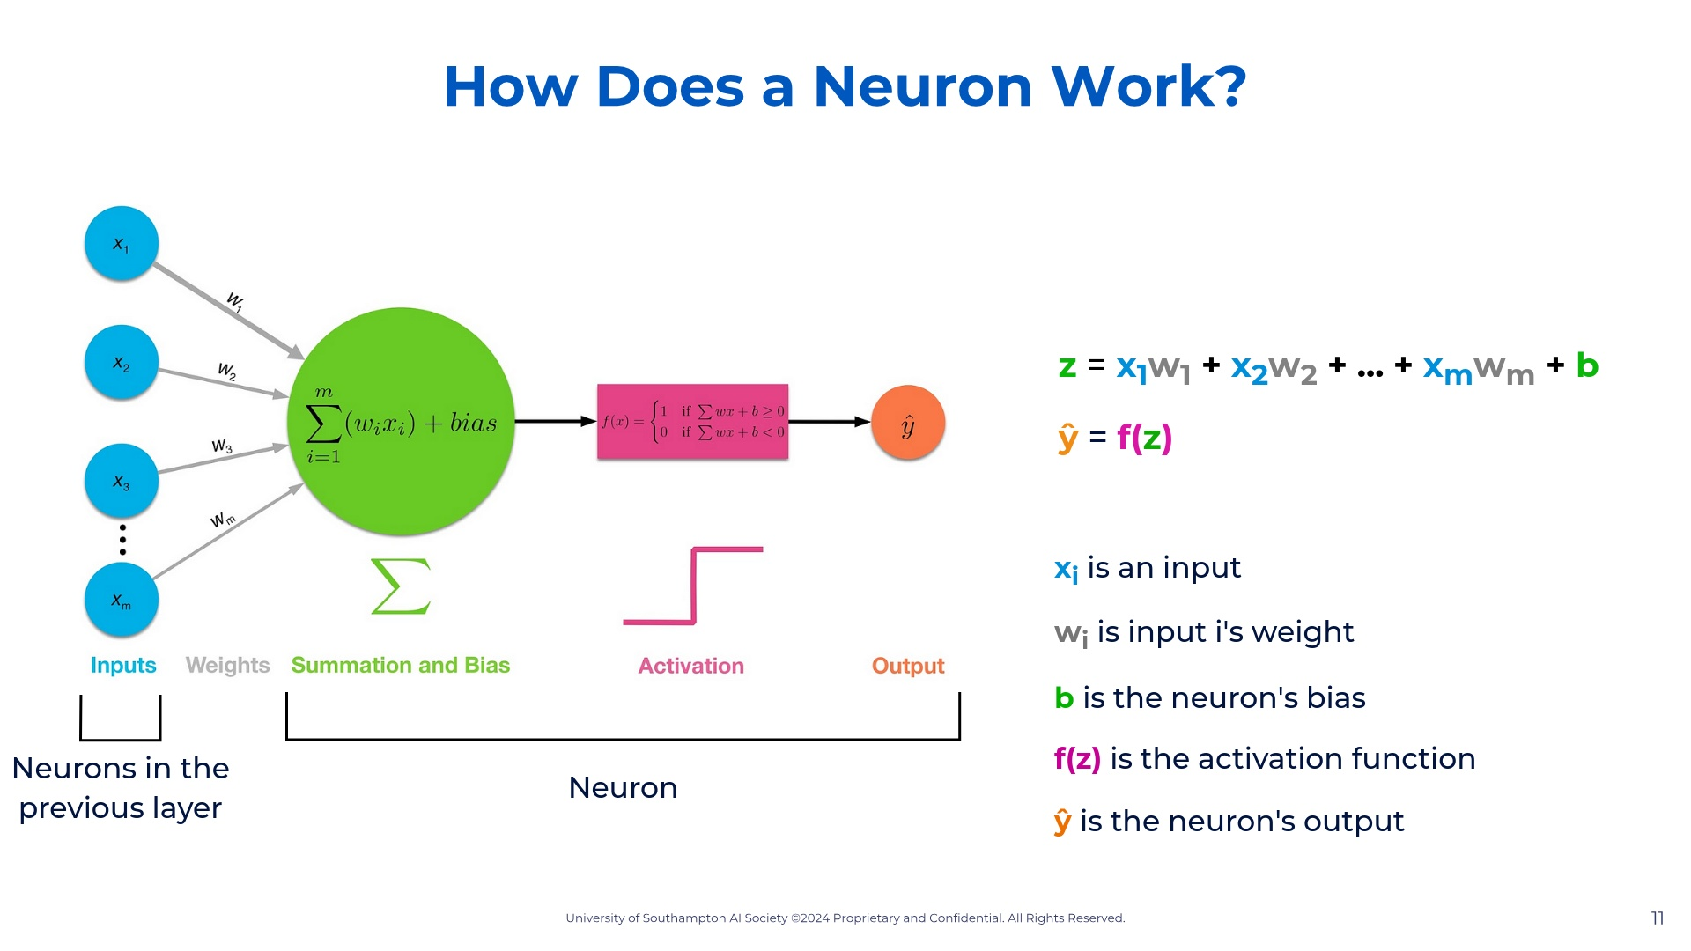

Slide 12
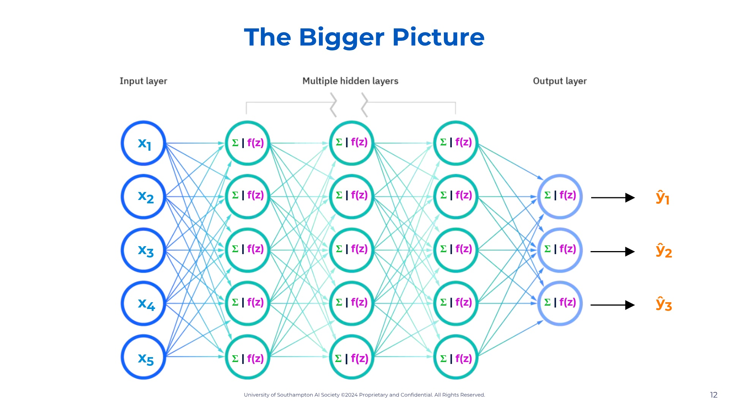

Slide 13


Slide 14
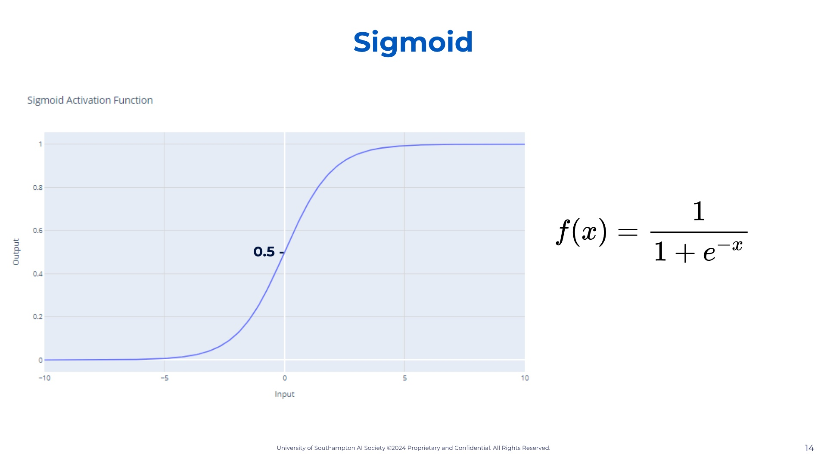

Slide 15
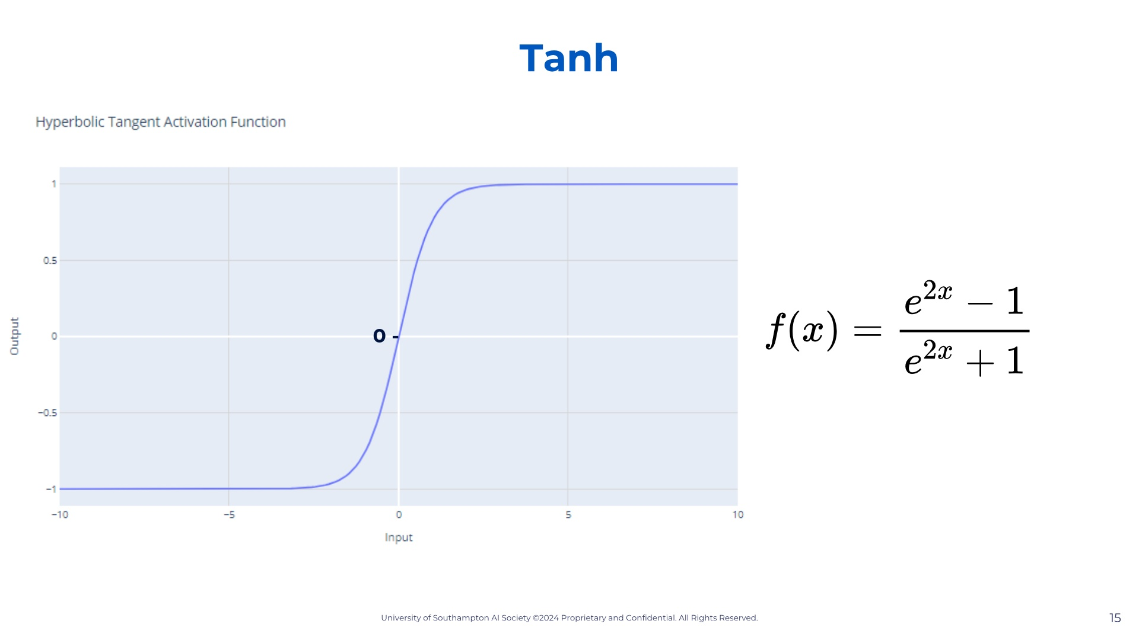

Slide 16
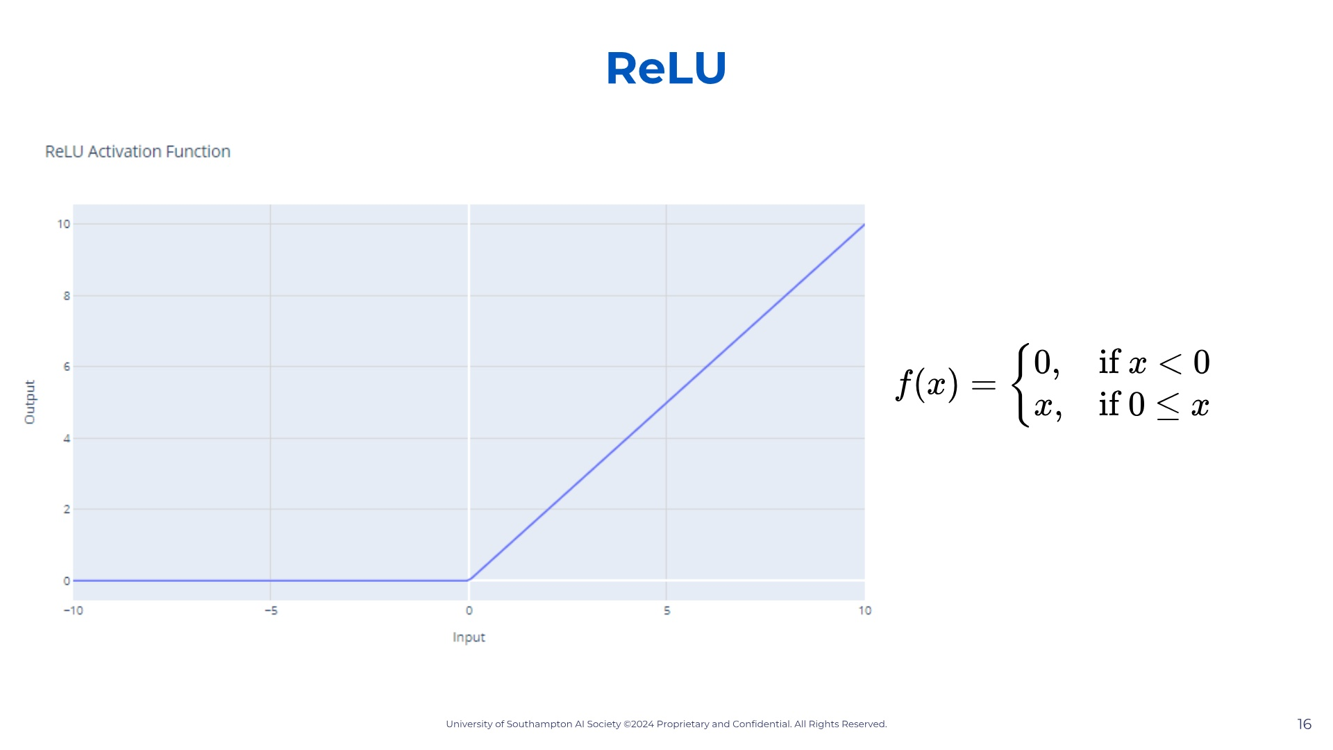

Slide 17


Slide 18


Slide 19
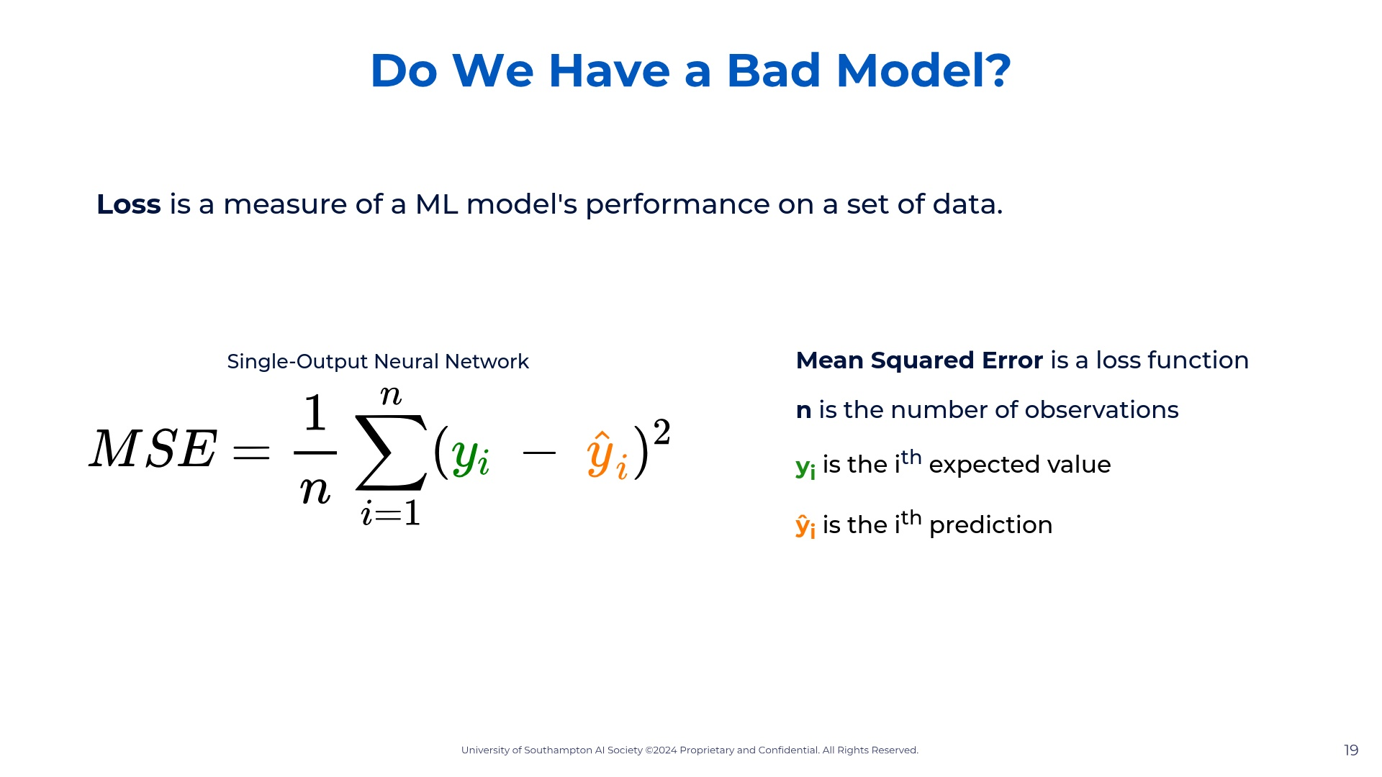

Slide 20
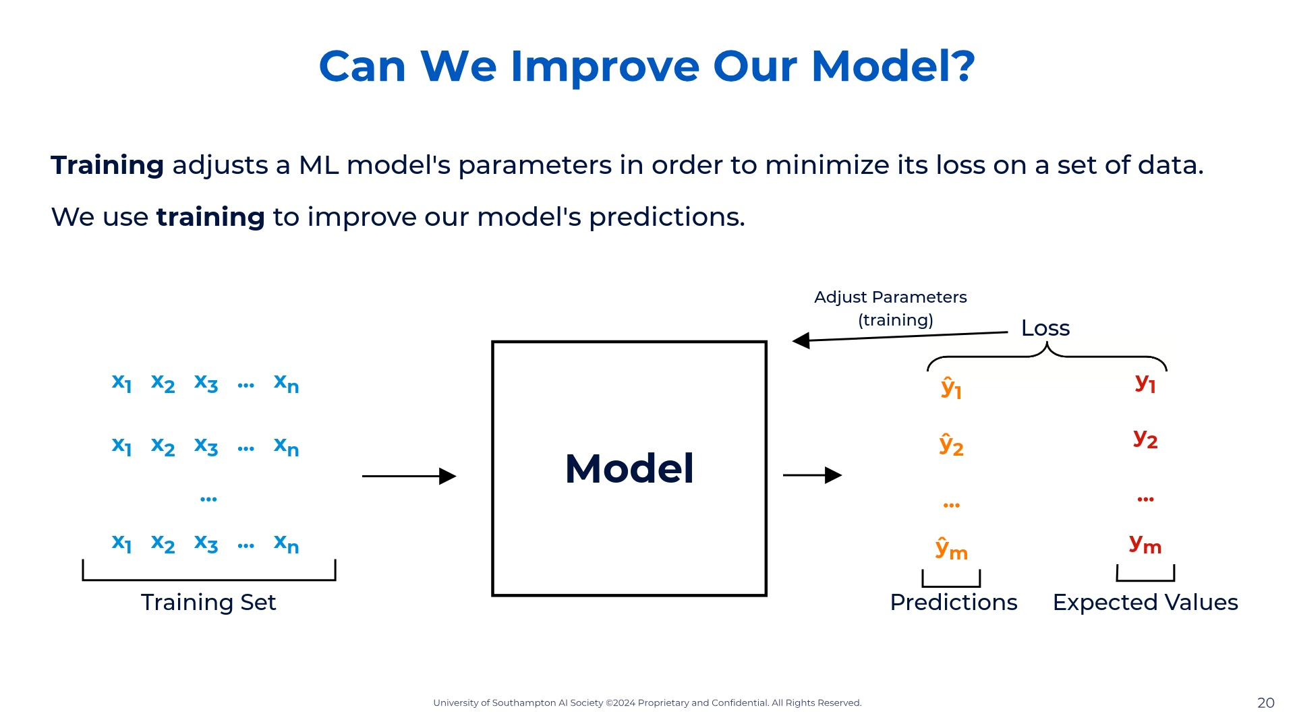

Slide 21
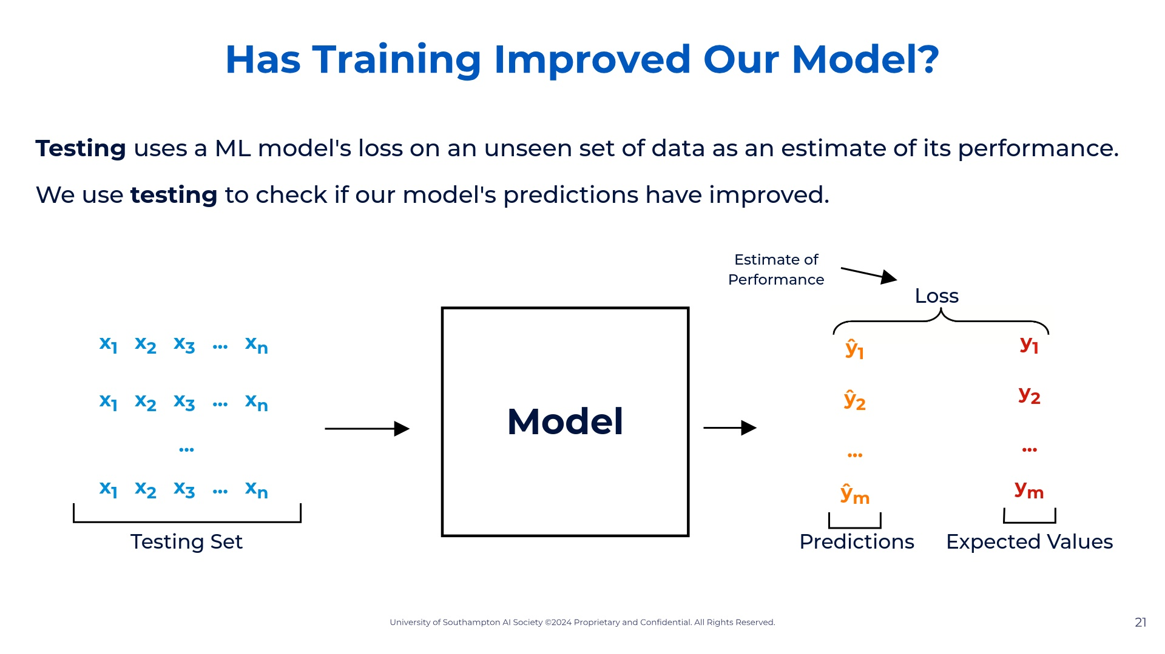

Slide 22


Slide 23
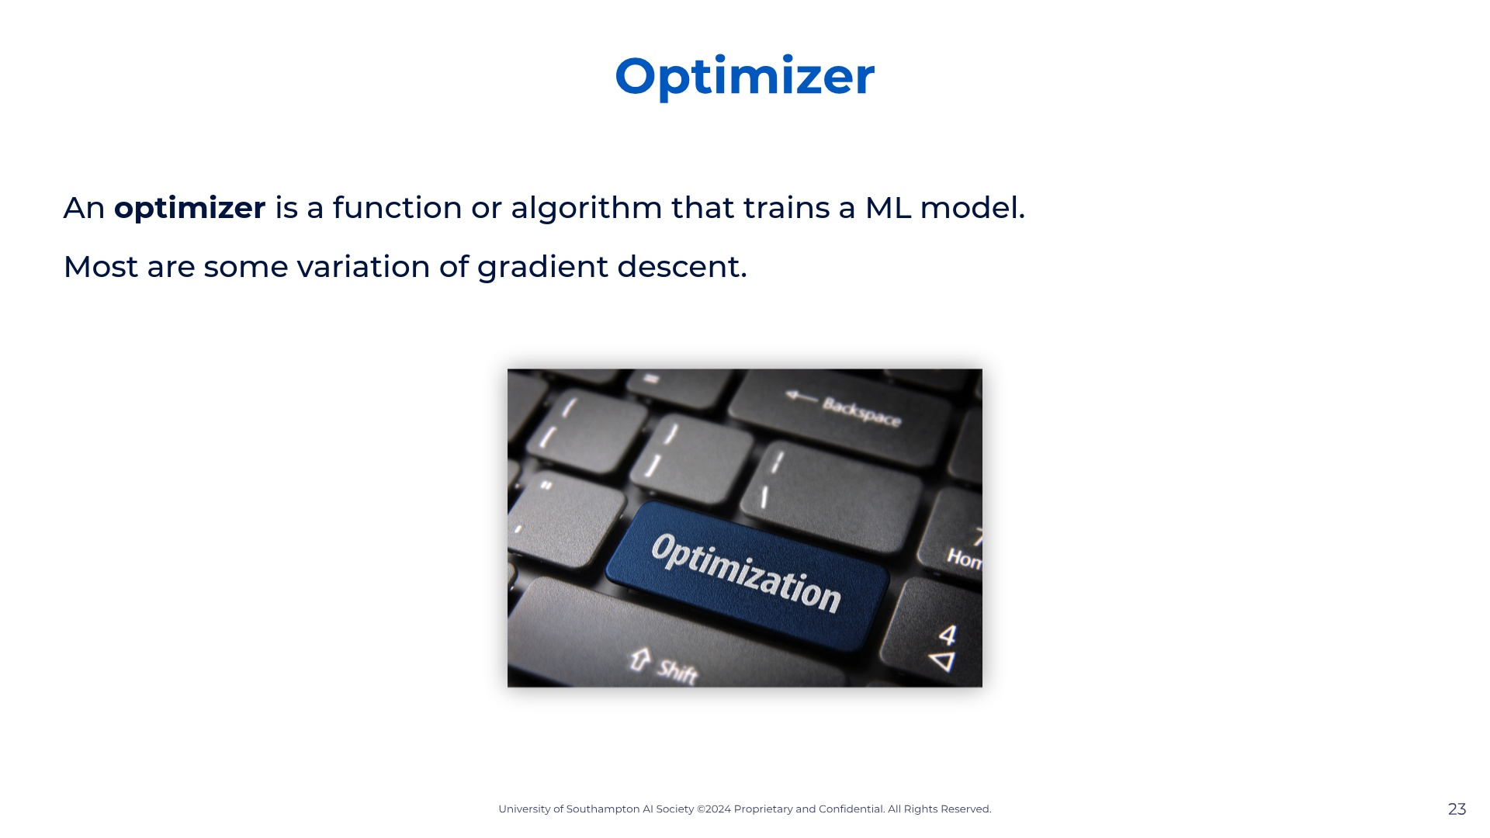

Slide 24
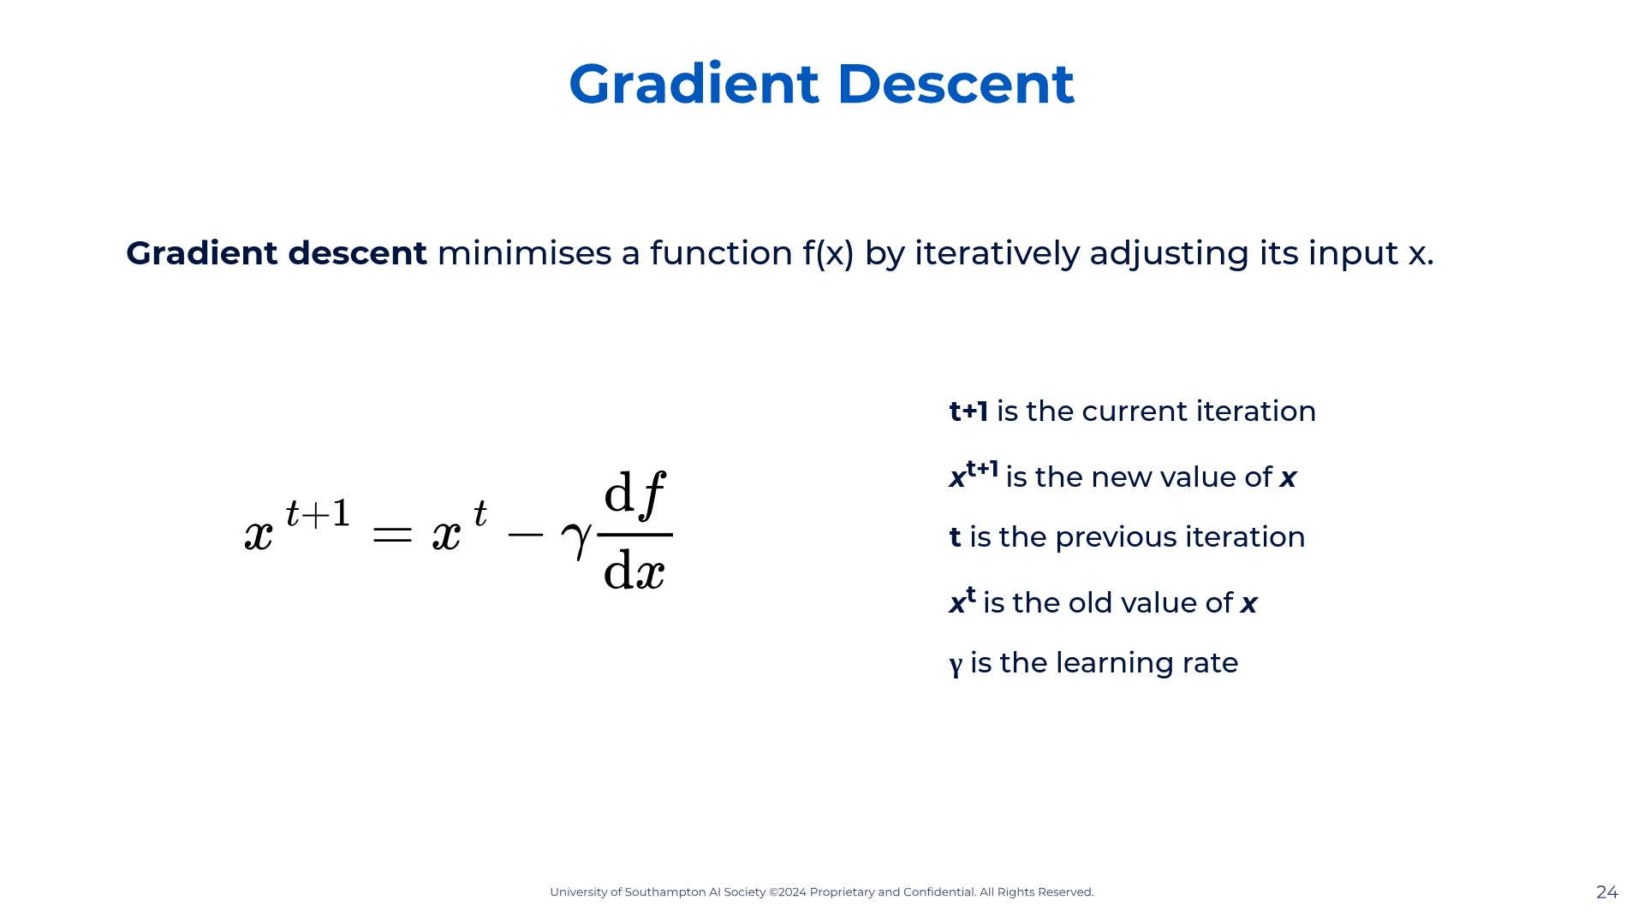

Slide 25
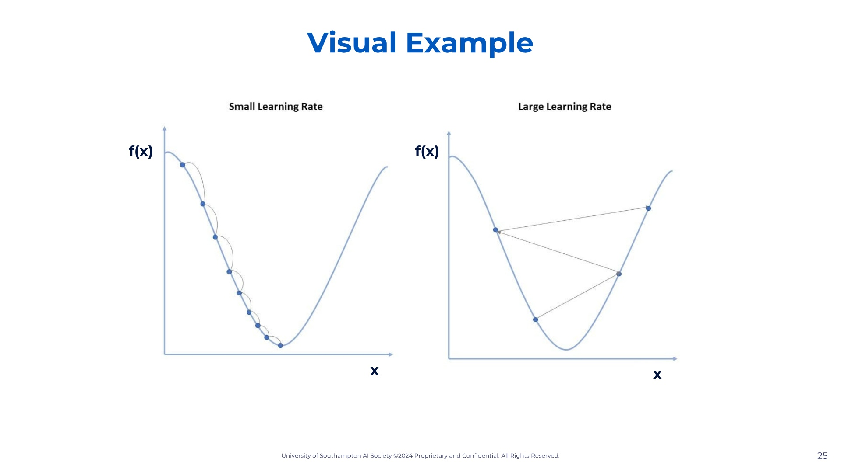

Slide 26
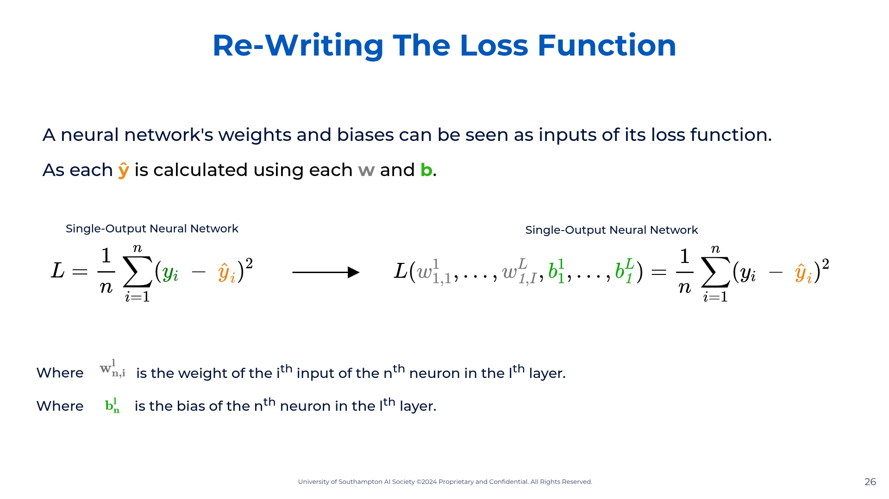

Slide 27
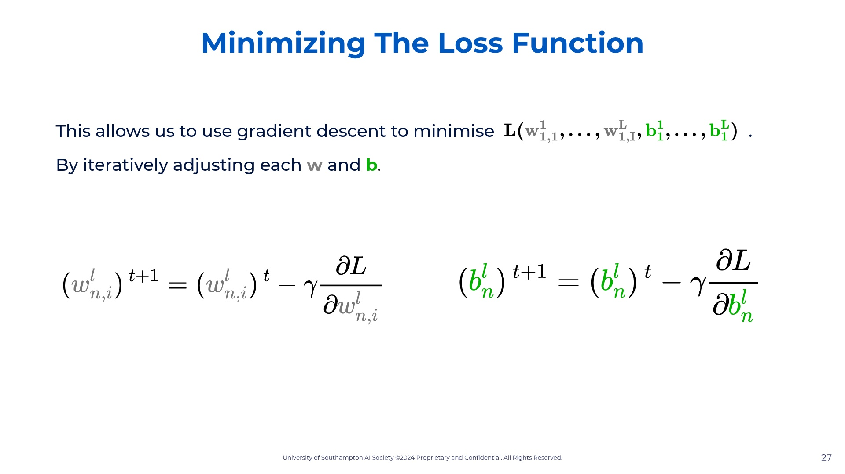

Slide 28
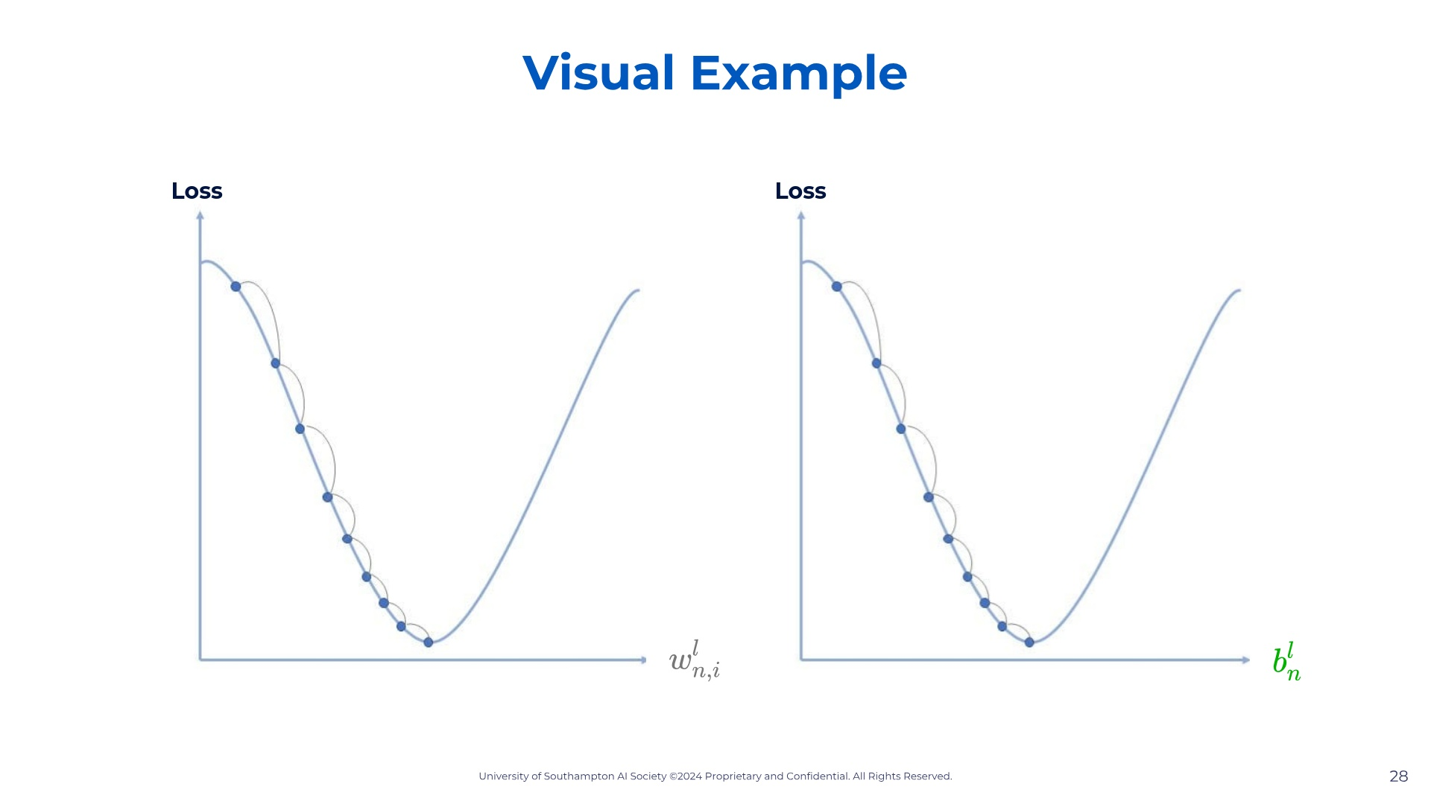

Slide 29


Slide 30
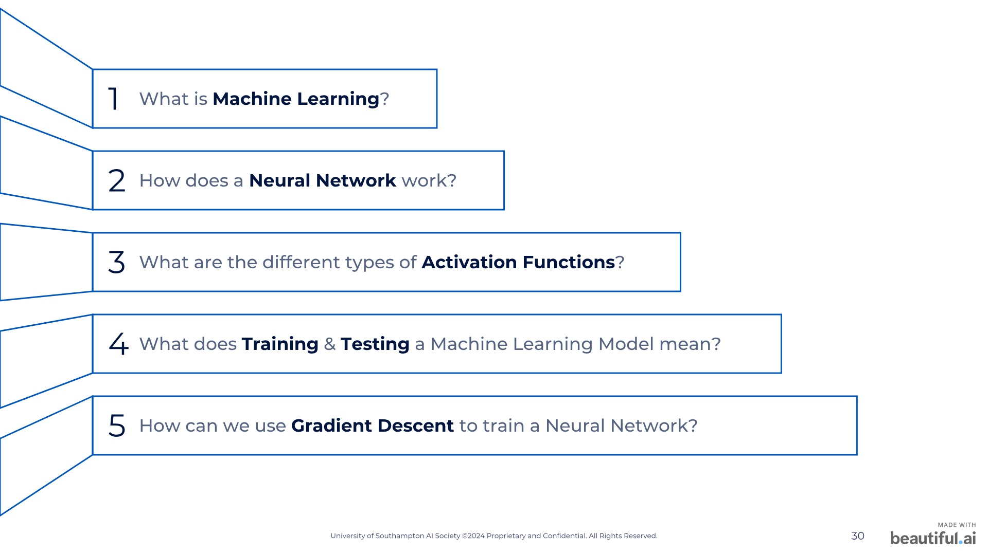

Slide 31


Slide 32
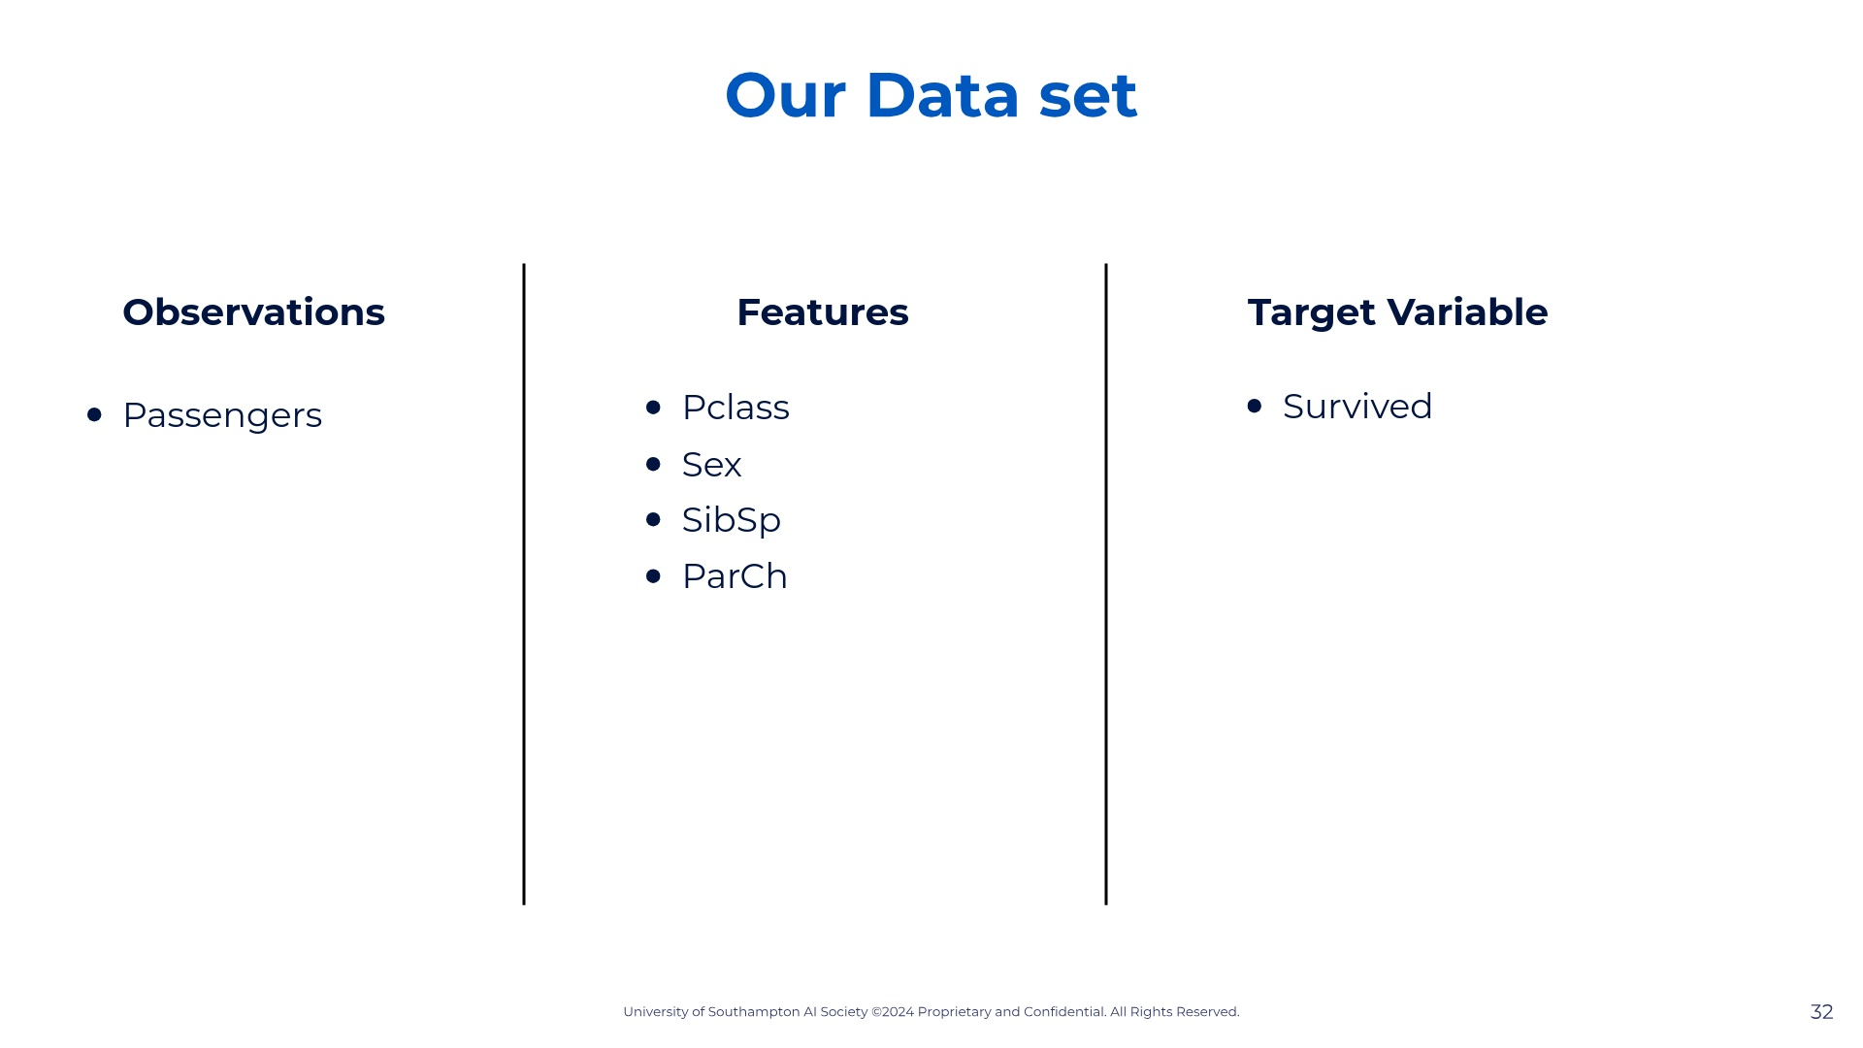

Slide 33
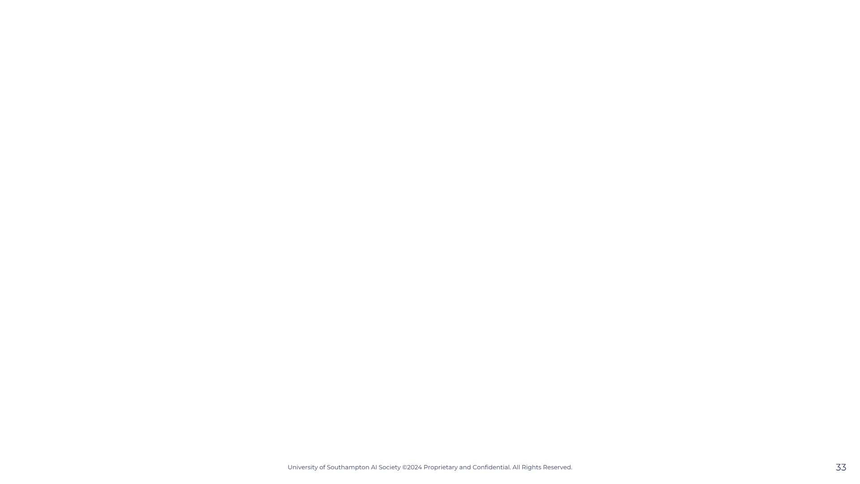

Slide 34
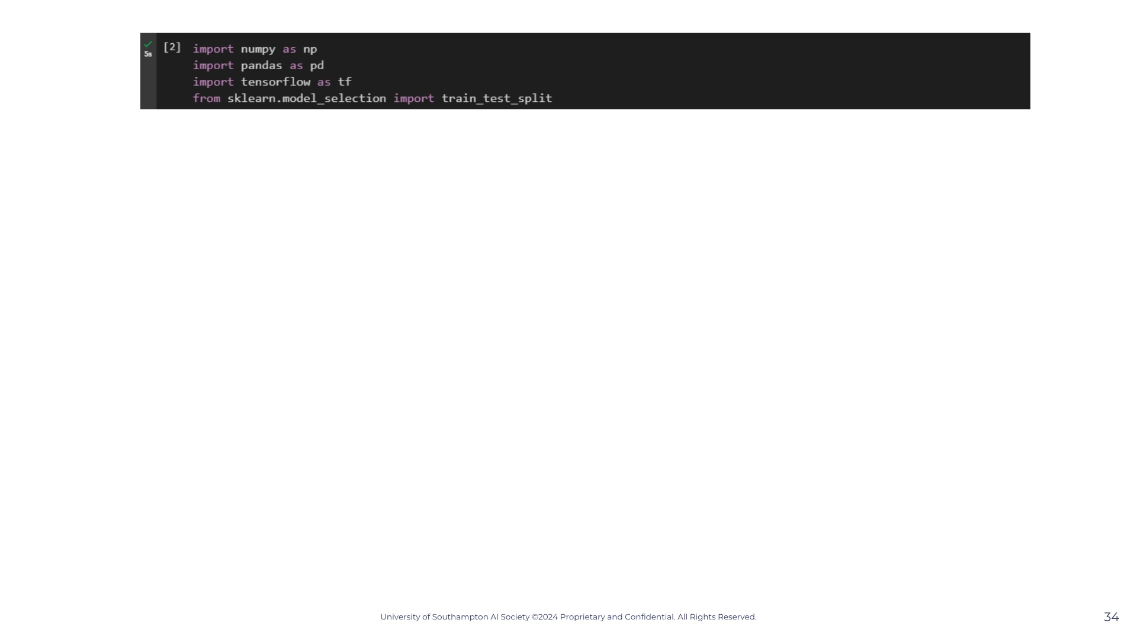
Notes:
— so as we were saying, what actually happens in each node after our input layer? Lets answer this by seeing what happens in one node only. — Well on our screen we have a very simple neural network with three inputs and one node that then give the neural networks output. What is actually happening in this node is that our x-inputs are being multiplied by a parameter called "weight". This weight value is any real number at all, that the computer chooses randomly, that varies between each x-input, and is multiplied with it's respective x-input. So we can weight1 x x1 + w2x2 + w3x3. The reason this is done is because it obviously increases the amount that each variable influences our our equation, because if we have a a w1 of 100 and a w2 of 1 then the x1 is going to be much bigger than x2. — As we have three x values and three w values, we can vectorise this and so have a matrix multiplication just to simplify the notation. If you don't know matrices that's fine just remember that this small z equation you see if the same as the one on top. — After that is done there is another value that is added with is the bias value. This constant is also randomly assigned and usually starts off with a value of 0 or 1. This is value you can think of as the constant b we have in linear equations. It's used to create a horizontal shift, which won't make much sense now but it will in a bit. — So now we have an equation z for this specific node, but we are still not done. Then the node runs this equation through what we call an activation function, which you can see on screen with the g(z). What is g(z)? Activation function. Our activation function is any function at all but the typically used ones are the sigmoid function and the ReLu function. Lets quickly go over them.

Slide 35
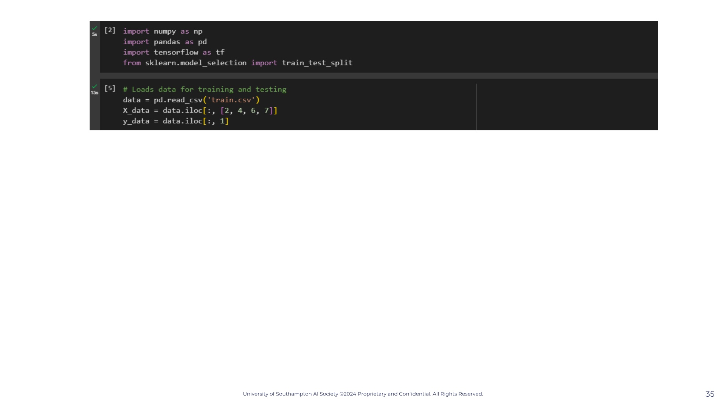

Slide 36
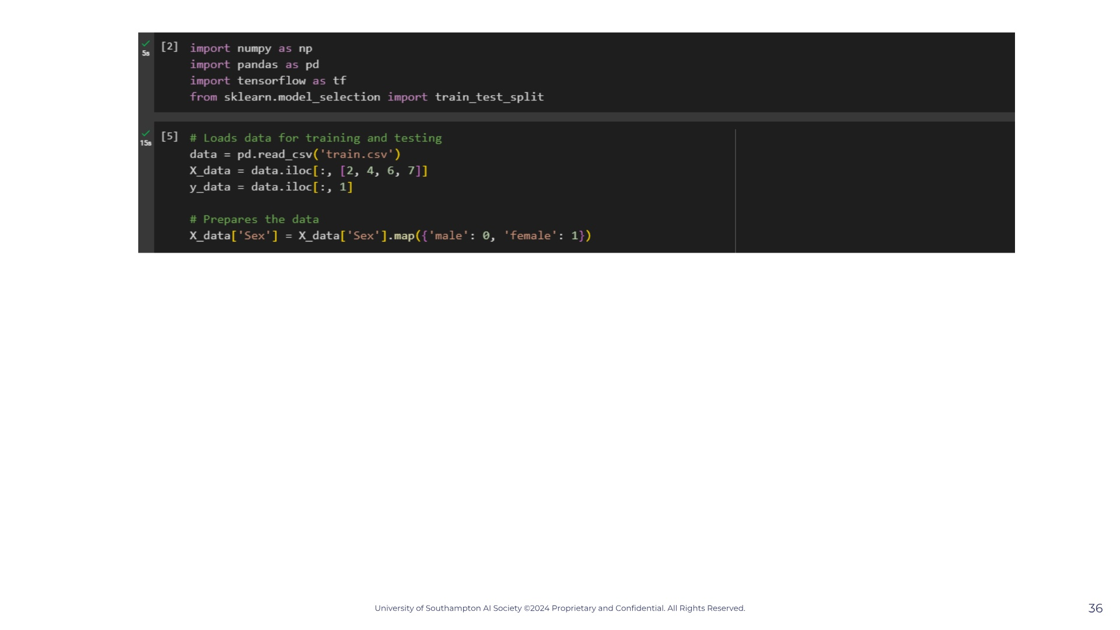

Slide 37
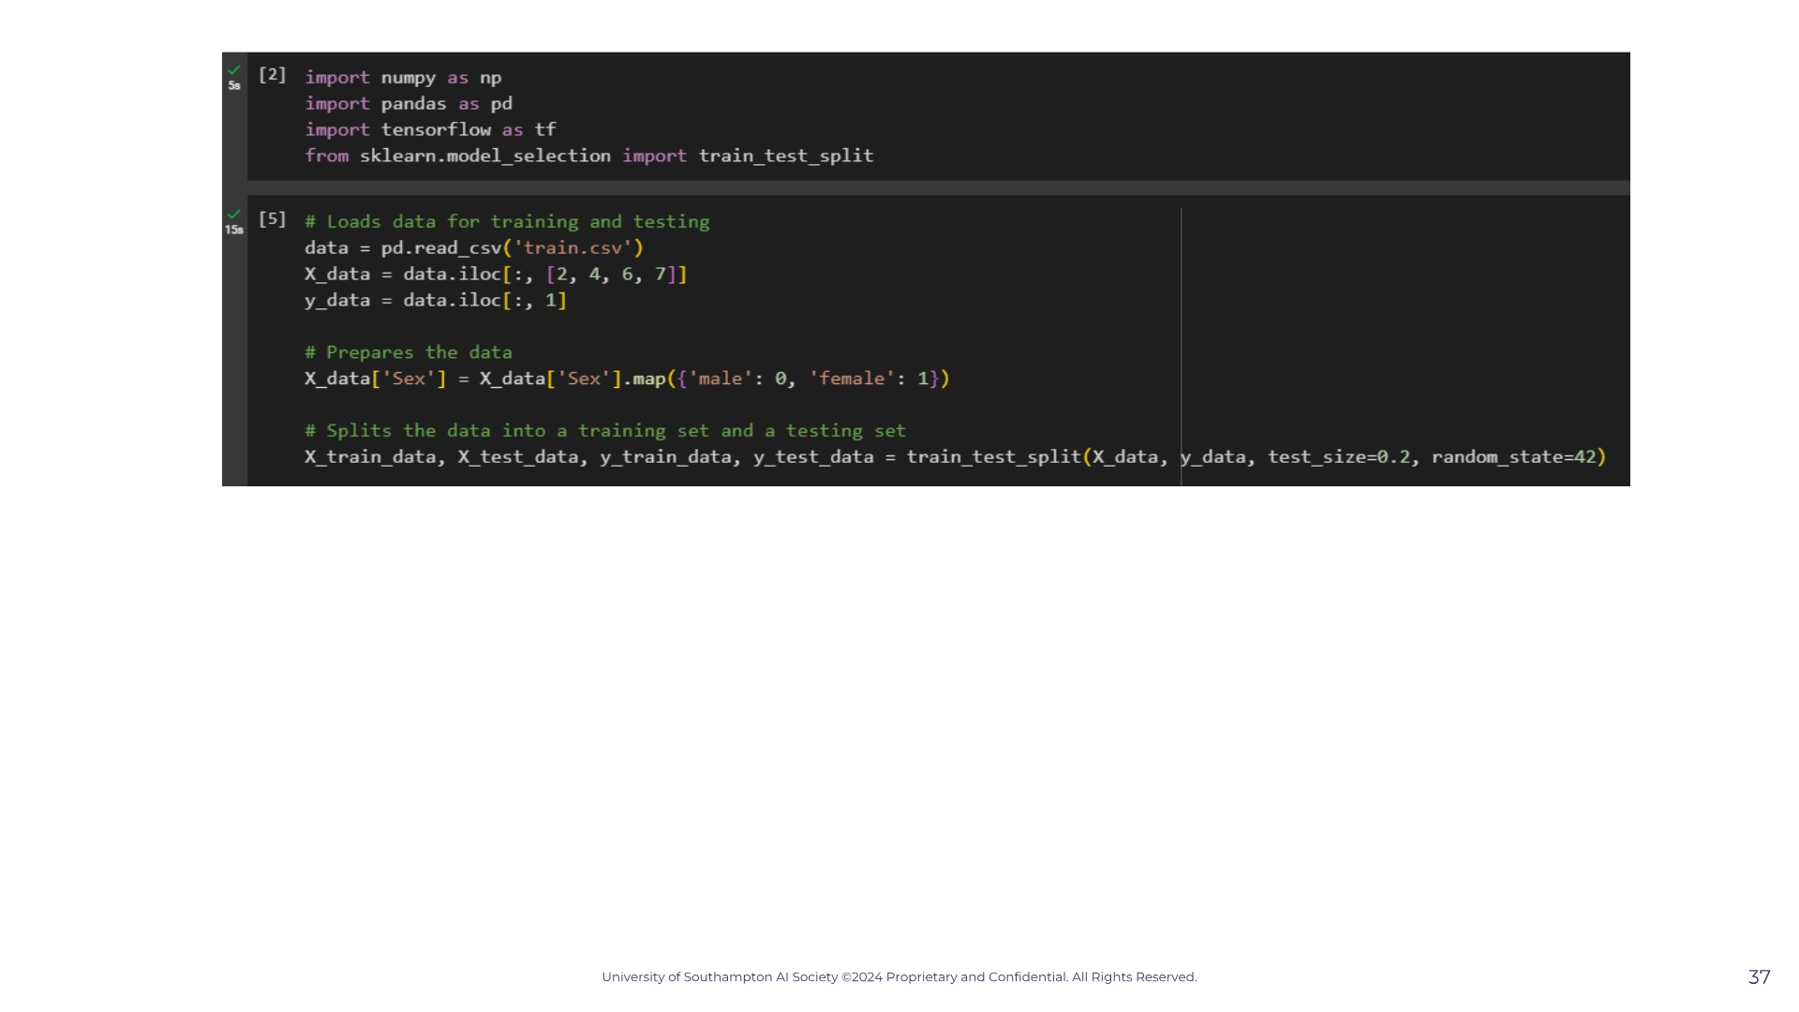

Slide 38
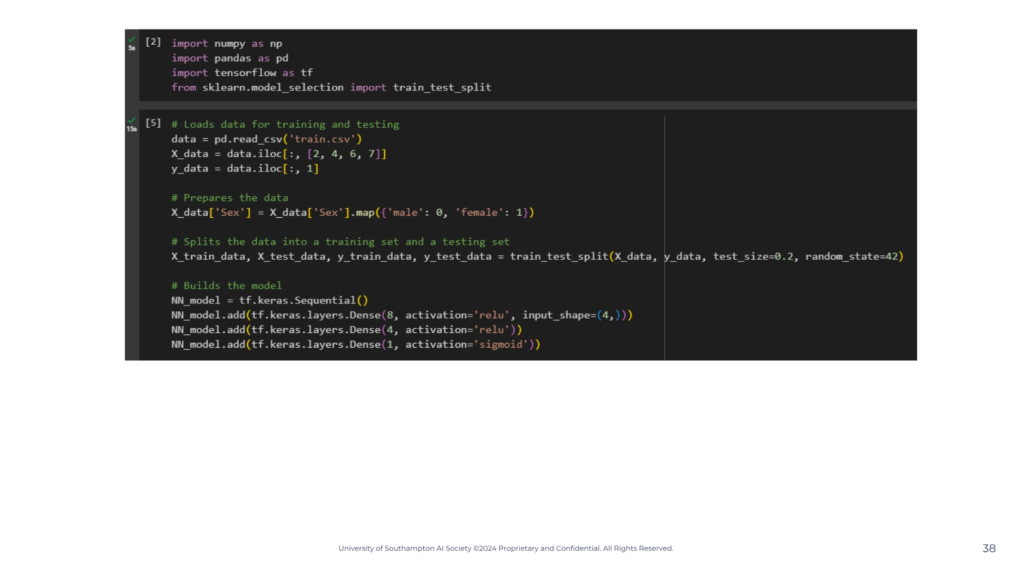
Notes:
— so as we were saying, what actually happens in each node after our input layer? Lets answer this by seeing what happens in one node only. — Well on our screen we have a very simple neural network with three inputs and one node that then give the neural networks output. What is actually happening in this node is that our x-inputs are being multiplied by a parameter called "weight". This weight value is any real number at all, that the computer chooses randomly, that varies between each x-input, and is multiplied with it's respective x-input. So we can weight1 x x1 + w2x2 + w3x3. The reason this is done is because it obviously increases the amount that each variable influences our our equation, because if we have a a w1 of 100 and a w2 of 1 then the x1 is going to be much bigger than x2. — As we have three x values and three w values, we can vectorise this and so have a matrix multiplication just to simplify the notation. If you don't know matrices that's fine just remember that this small z equation you see if the same as the one on top. — After that is done there is another value that is added with is the bias value. This constant is also randomly assigned and usually starts off with a value of 0 or 1. This is value you can think of as the constant b we have in linear equations. It's used to create a horizontal shift, which won't make much sense now but it will in a bit. — So now we have an equation z for this specific node, but we are still not done. Then the node runs this equation through what we call an activation function, which you can see on screen with the g(z). What is g(z)? Activation function. Our activation function is any function at all but the typically used ones are the sigmoid function and the ReLu function. Lets quickly go over them.

Slide 39
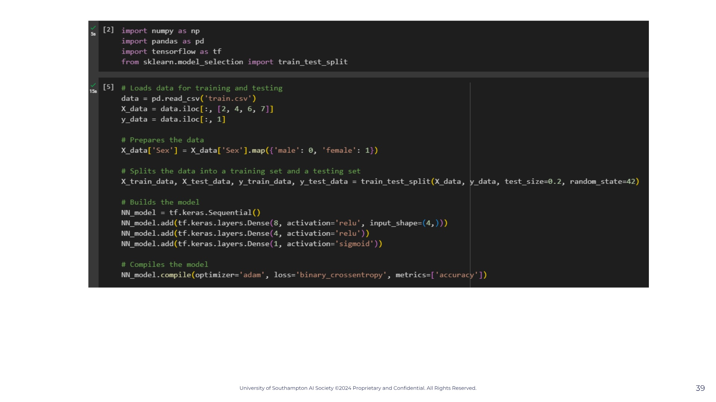
Notes:
— so as we were saying, what actually happens in each node after our input layer? Lets answer this by seeing what happens in one node only. — Well on our screen we have a very simple neural network with three inputs and one node that then give the neural networks output. What is actually happening in this node is that our x-inputs are being multiplied by a parameter called "weight". This weight value is any real number at all, that the computer chooses randomly, that varies between each x-input, and is multiplied with it's respective x-input. So we can weight1 x x1 + w2x2 + w3x3. The reason this is done is because it obviously increases the amount that each variable influences our our equation, because if we have a a w1 of 100 and a w2 of 1 then the x1 is going to be much bigger than x2. — As we have three x values and three w values, we can vectorise this and so have a matrix multiplication just to simplify the notation. If you don't know matrices that's fine just remember that this small z equation you see if the same as the one on top. — After that is done there is another value that is added with is the bias value. This constant is also randomly assigned and usually starts off with a value of 0 or 1. This is value you can think of as the constant b we have in linear equations. It's used to create a horizontal shift, which won't make much sense now but it will in a bit. — So now we have an equation z for this specific node, but we are still not done. Then the node runs this equation through what we call an activation function, which you can see on screen with the g(z). What is g(z)? Activation function. Our activation function is any function at all but the typically used ones are the sigmoid function and the ReLu function. Lets quickly go over them.

Slide 40
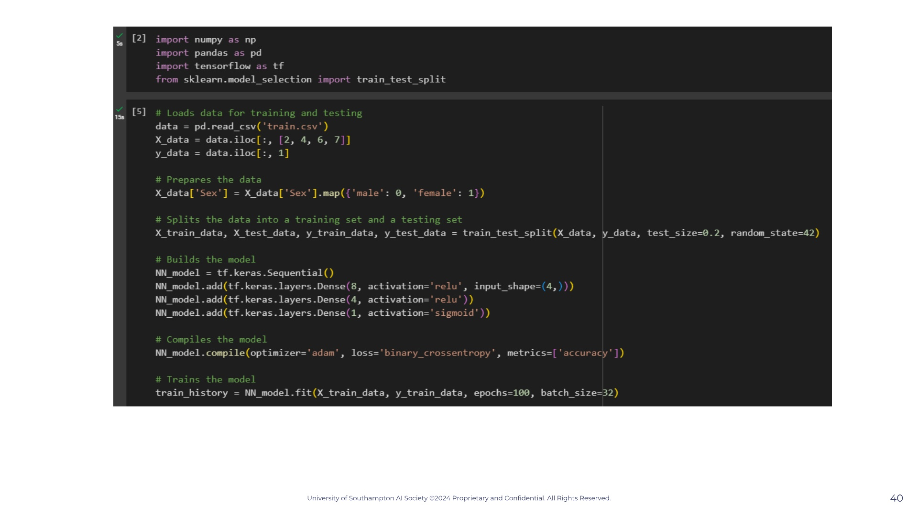
Notes:
— so as we were saying, what actually happens in each node after our input layer? Lets answer this by seeing what happens in one node only. — Well on our screen we have a very simple neural network with three inputs and one node that then give the neural networks output. What is actually happening in this node is that our x-inputs are being multiplied by a parameter called "weight". This weight value is any real number at all, that the computer chooses randomly, that varies between each x-input, and is multiplied with it's respective x-input. So we can weight1 x x1 + w2x2 + w3x3. The reason this is done is because it obviously increases the amount that each variable influences our our equation, because if we have a a w1 of 100 and a w2 of 1 then the x1 is going to be much bigger than x2. — As we have three x values and three w values, we can vectorise this and so have a matrix multiplication just to simplify the notation. If you don't know matrices that's fine just remember that this small z equation you see if the same as the one on top. — After that is done there is another value that is added with is the bias value. This constant is also randomly assigned and usually starts off with a value of 0 or 1. This is value you can think of as the constant b we have in linear equations. It's used to create a horizontal shift, which won't make much sense now but it will in a bit. — So now we have an equation z for this specific node, but we are still not done. Then the node runs this equation through what we call an activation function, which you can see on screen with the g(z). What is g(z)? Activation function. Our activation function is any function at all but the typically used ones are the sigmoid function and the ReLu function. Lets quickly go over them.

Slide 41
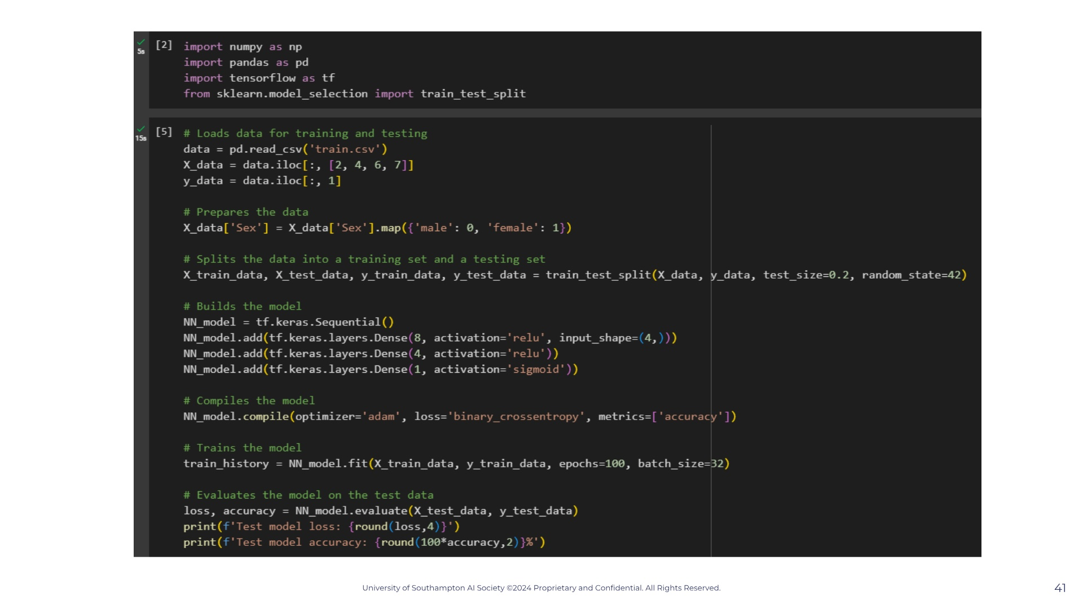

Slide 42
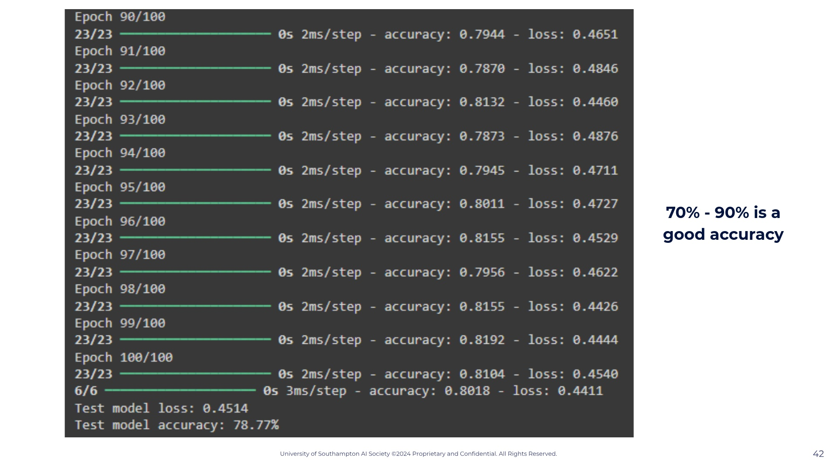

Slide 43


Slide 44
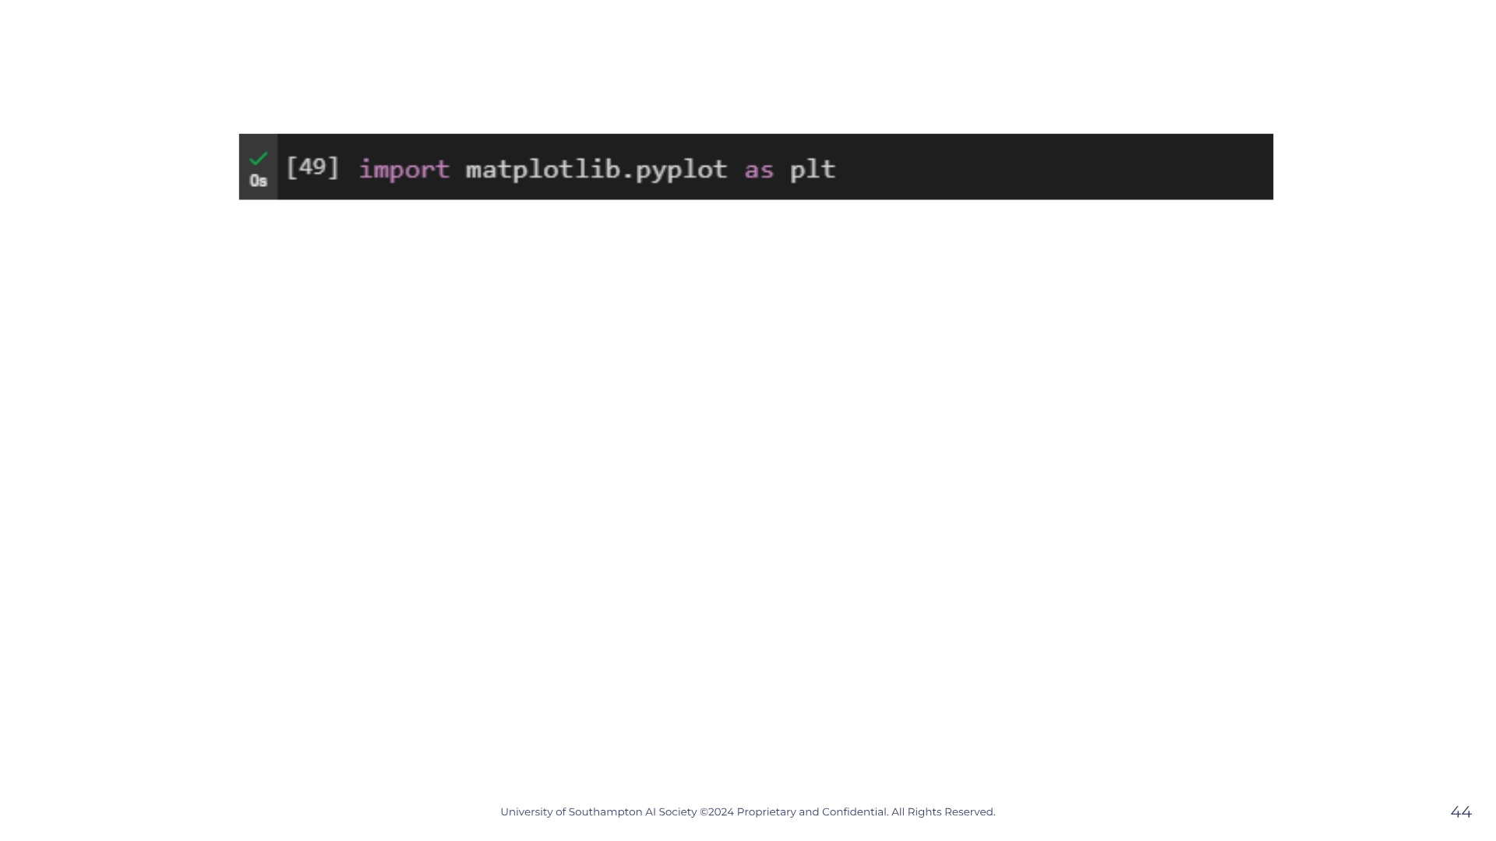

Slide 45
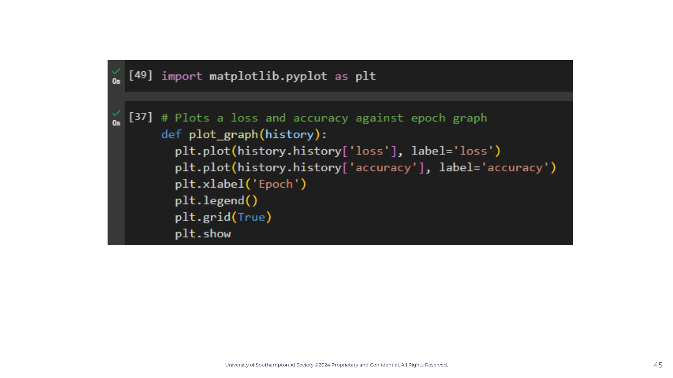

Slide 46
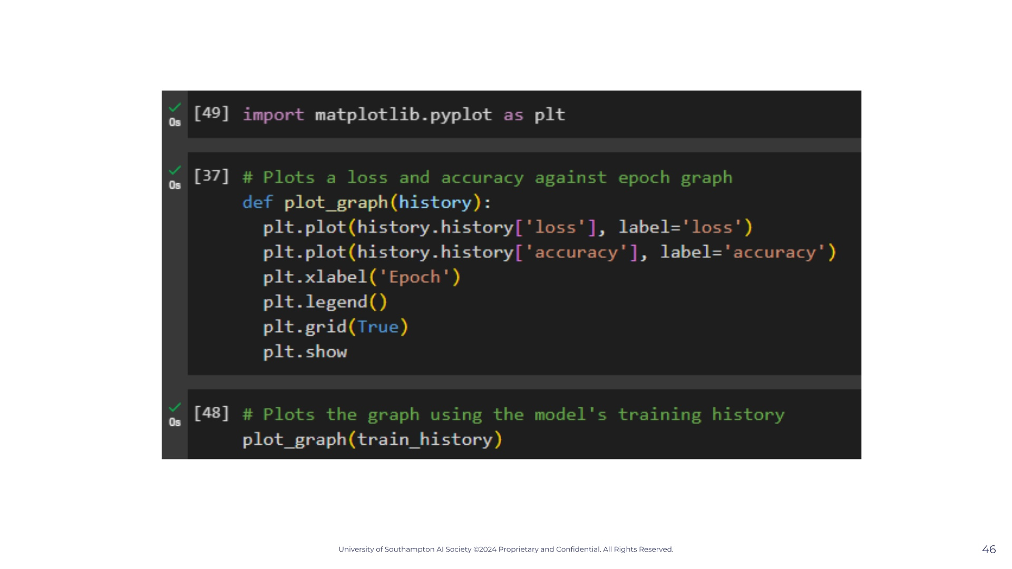

Slide 47
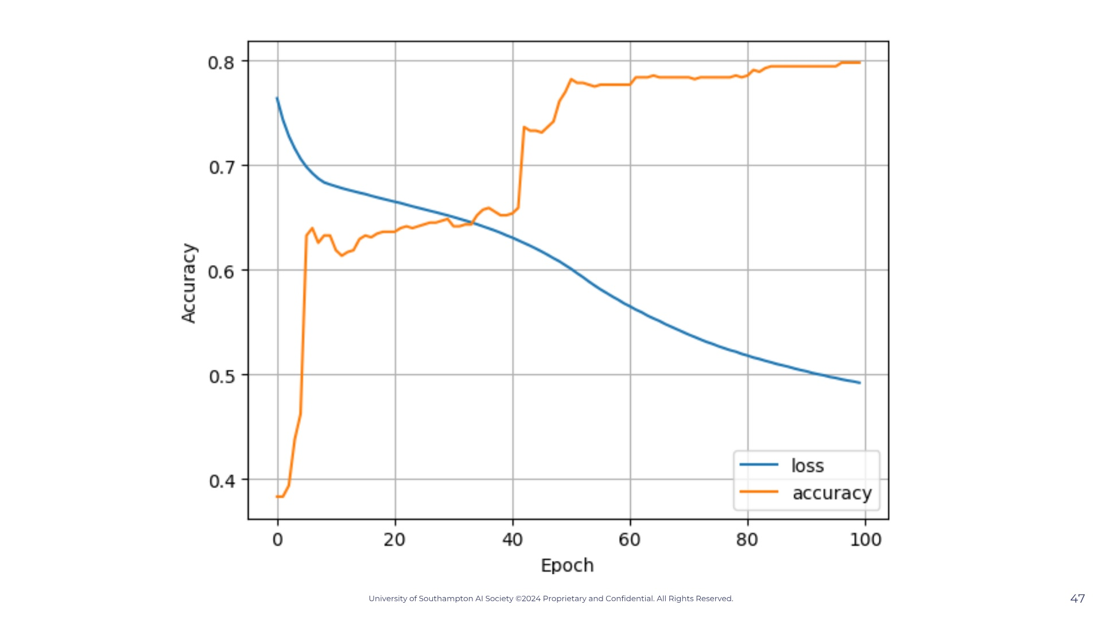

Slide 48


Slide 49
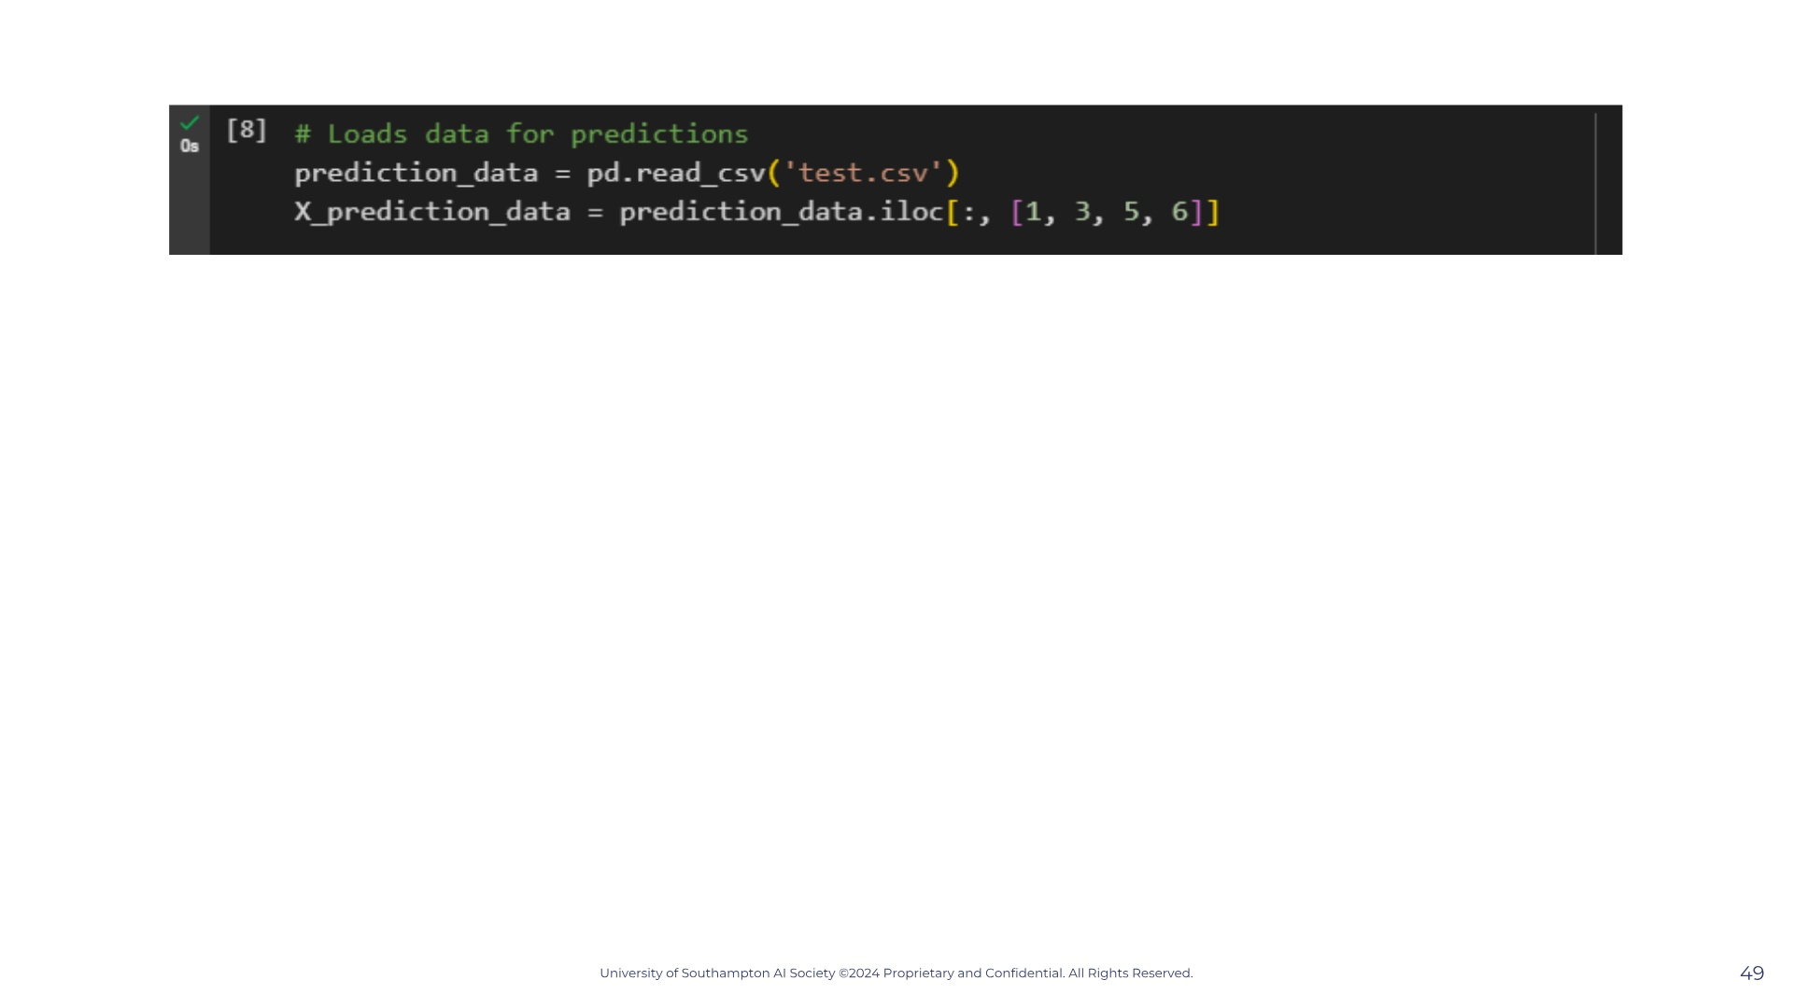

Slide 50
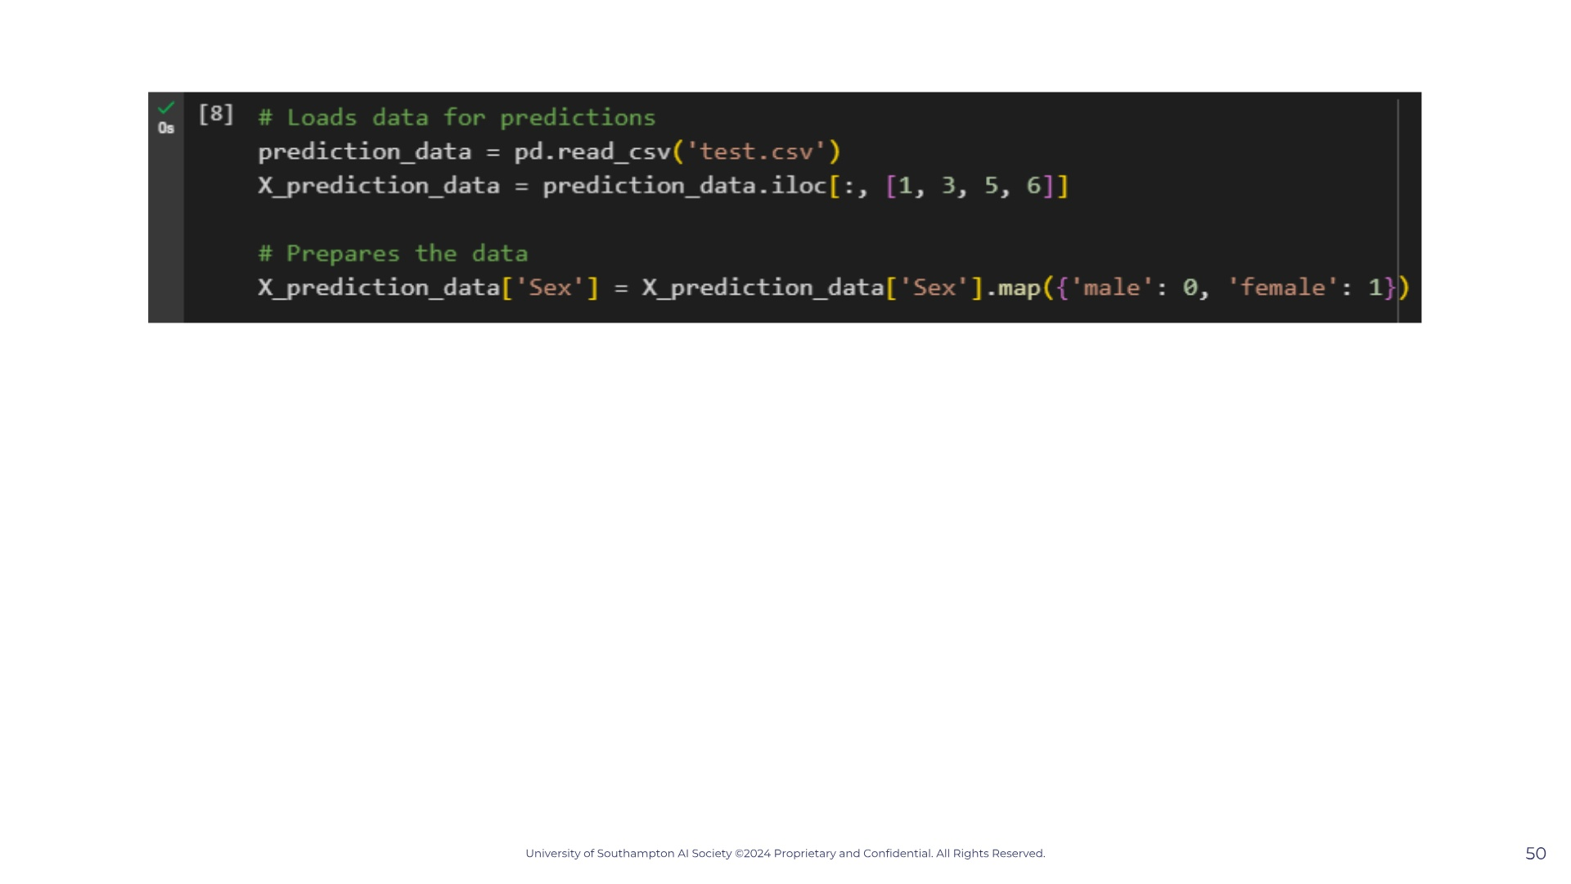

Slide 51
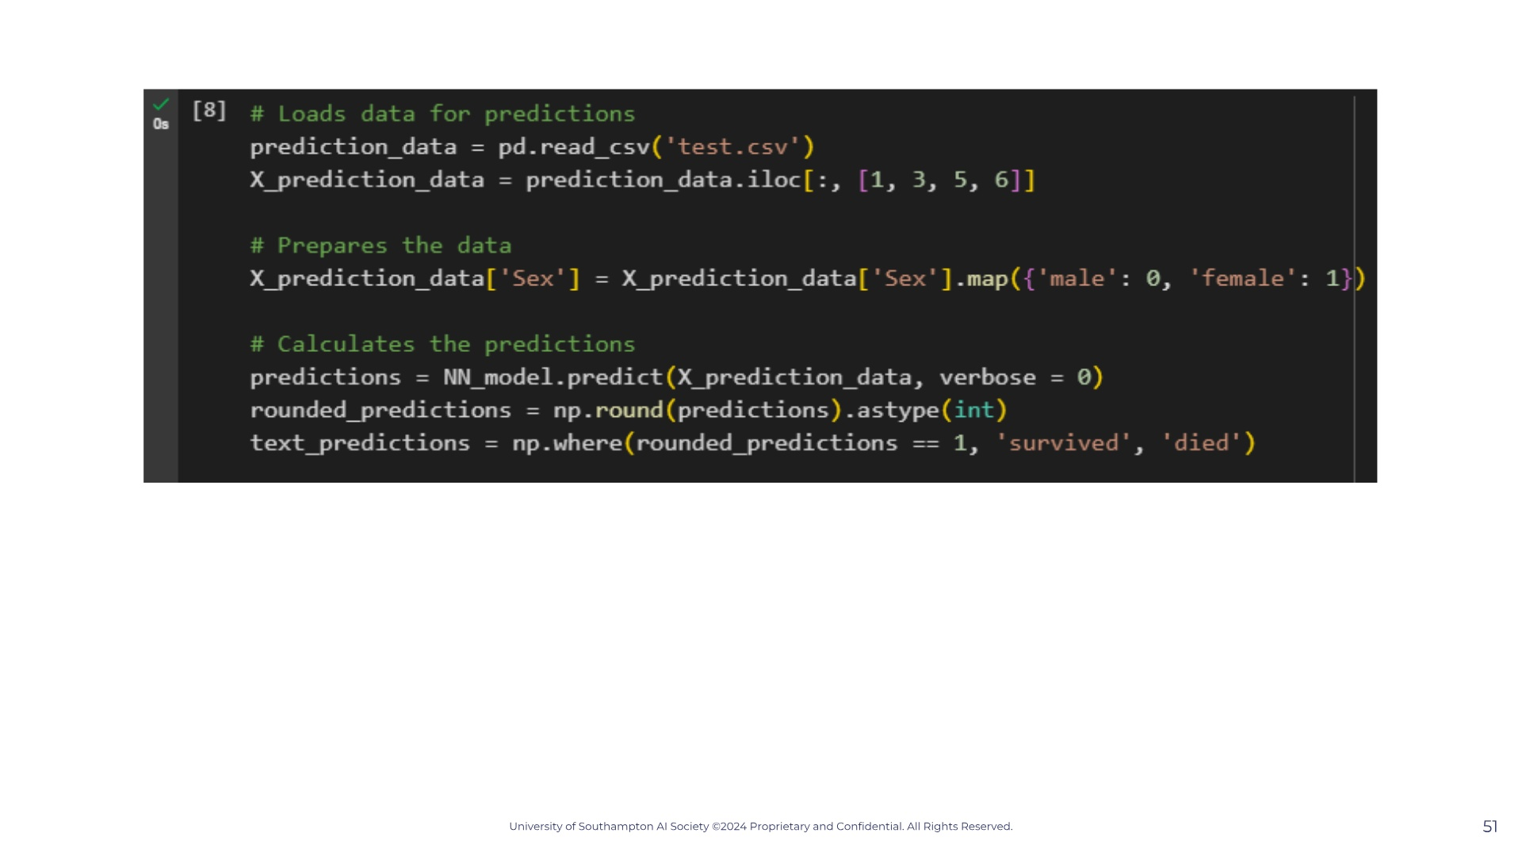

Slide 52
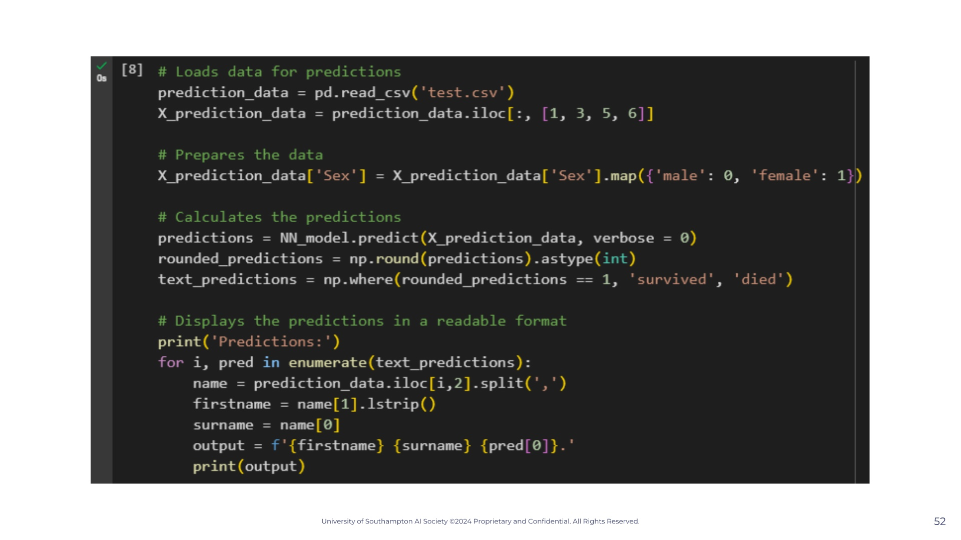

Slide 53
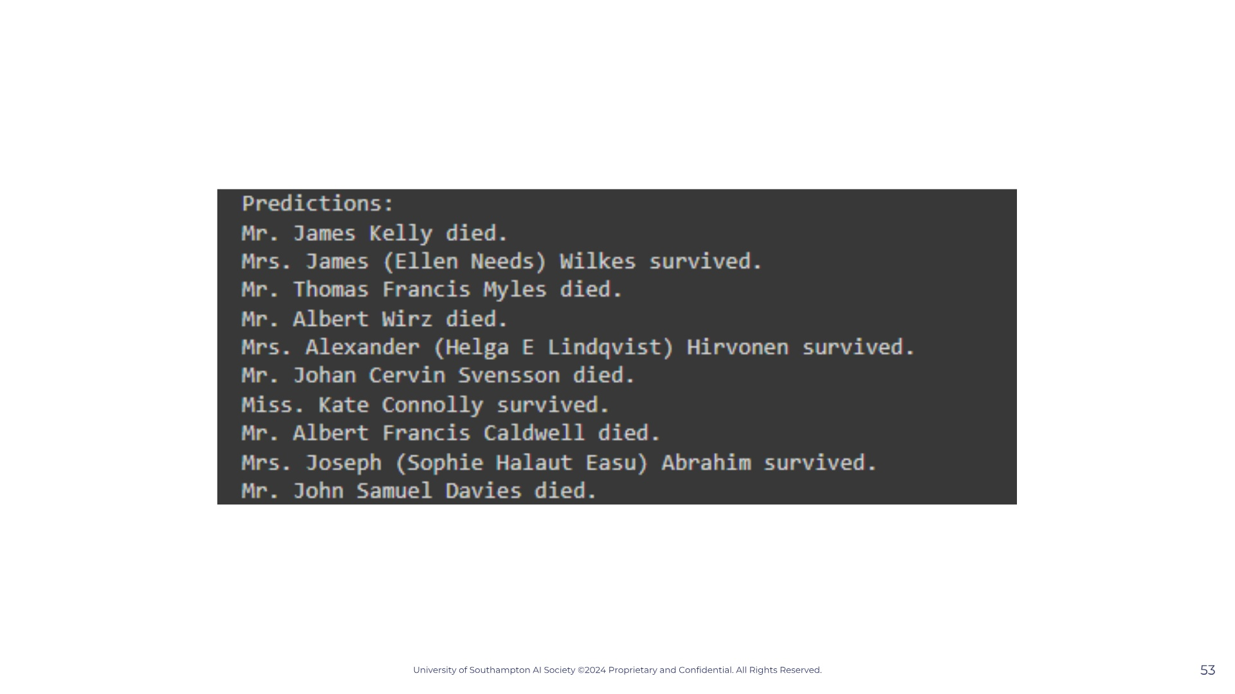

Slide 54


